Slide 1




LENDI INSTITUTE OF ENGINEERING AND TECHNOLGOY
(Autonomous)
Approved by AICTE and Permanently affiliated to JNTU Gurajada-Vizianagaram.
ECE,EEE,CSE&MECH
DEPARTMENT OF COMPUTER SCIENCE AND ENGINEERING
NAME OF THE SUBJECT : Natural Language Processing
NAME OF THE TOPIC : Language Modelling
PRESENTED BY :
Mrs. P. Sangeeta
Assistant Professor

Slide 2
Language Modelling :
Predicting the next word in a sentence or sequence of words based on the context and previous words.
Importance:
- enables machines to understand and generate human-like text, enhancing the capabilities of chatbots, virtual assistants, and other AI-powered systems.
- Aids businesses in deriving valuable insights and making data-driven decisions from vast amounts of textual data.

Slide 3
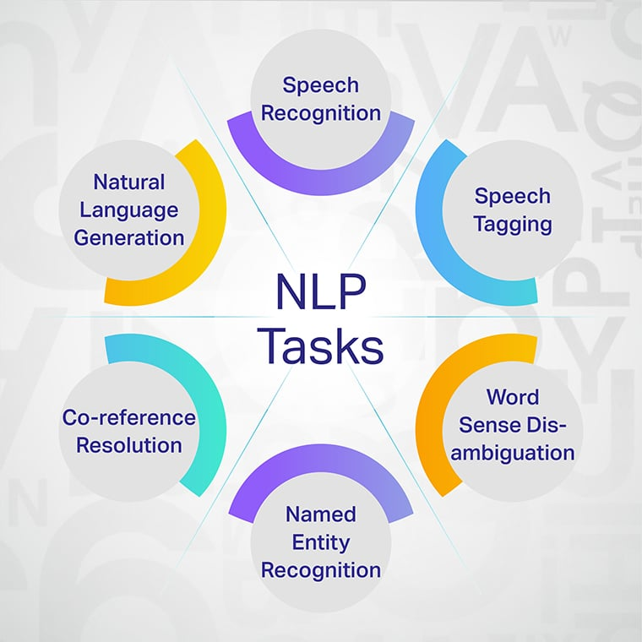
NLP Tasks:

Slide 4
Language Modelling Use cases
Machine Translation
Text Generation
Speech Recognition
Question Answering
Named Entity Recognition

Slide 5
How does LM work?
determine word probability by analyzing text data
interpret this data by feeding it through an algorithm that establishes rules for context in natural language.
model applies these rules in language tasks to accurately predict or produce new sentences.
model essentially learns the features and characteristics of basic language and uses those features to understand new phrases.

Slide 6
Types of Language Modelling
Grammar-based Language Modelling
Statistical - based Language Modelling

Slide 7
Grammar-based Language Modelling
refers to an approach where formal grammatical rules are used to define the structure and syntax of a language.

Slide 8
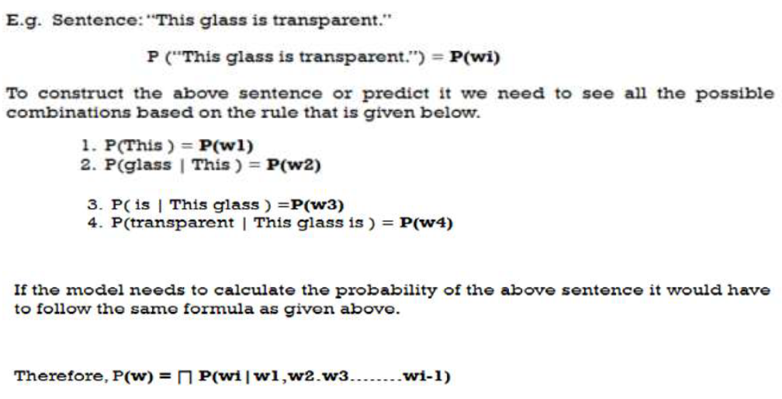
Example:

Slide 9
Applications:
Speech Recognition
Machine Translation
Chat bots & Virtual Assistants
Text-to-Speech Systems

Slide 10
Statistical-based Language Modelling
approach that uses probability and statistics to predict the likelihood of a sequence of words occurring in a language.
It is based on the idea that the structure of language can be learned from large text corpora by analyzing how often words or phrases appear together.

Slide 11
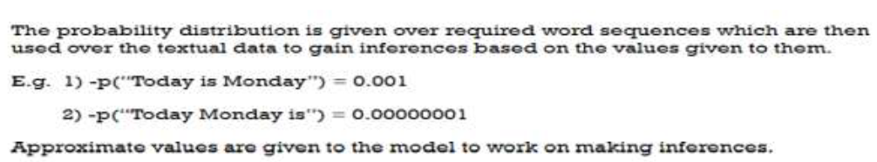
Example:

Slide 12
Applications:
Text Prediction & Autocomplete
Spelling & Grammar Correction
Sentiment Analysis & Text Classification
Information Retrieval & Search Engines
Named Entity Recognition (NER) & Information Extraction

Slide 13


