Slide 1




DEPARTMENT OF COMPUTER SCIENCE
AND ENGINEERING
NAME OF THE SUBJECT : Advanced Computer Networks
NAME OF THE TOPIC : Unit 4 – TCP
PRESENTED BY :
Mr M Ch J Sekhar
Assistant Professor

Slide 2
Transmission Control Protocol
(TCP)

Slide 3
OBJECTIVES:
To introduce TCP as a protocol that provides reliable stream delivery service.
To define TCP features and compare them with UDP features.
To define the format of a TCP segment and its fields.
To show how TCP provides a connection-oriented service, and show the segments exchanged during connection establishment and connection termination phases.
To discuss the state transition diagram for TCP and discuss some scenarios.
To introduce windows in TCP that are used for flow and error control.

Slide 4
OBJECTIVES (continued):
To discuss how TCP implements flow control in which the receive window controls the size of the send window.
To discuss error control and FSMs used by TCP during the data transmission phase.
To discuss how TCP controls the congestion in the network using different strategies.
To list and explain the purpose of each timer in TCP.
To discuss options in TCP and show how TCP can provide selective acknowledgment using the SACK option.
To give a layout and a simplified pseudocode for the TCP package.

Slide 5
TCP Services
TCP Features
Segment
A TCP Connection
State Transition Diagram
Windows in TCP
Flow Control
Error Control
Congestion Control
TCP Timers
Options
TCP Package

Slide 6
TCP SERVICES
Figure shows the relationship of TCP to the other protocols in the TCP/IP protocol suite. TCP lies between the application layer and the network layer, and serves as the intermediary between the application programs and the network operations.

Slide 7
Topics Discussed in the Section
Process-to-Process Communication
Stream Delivery Service
Full-Duplex Communication
Multiplexing and Demultiplexing
Connection-Oriented Service
Reliable Service

Slide 8
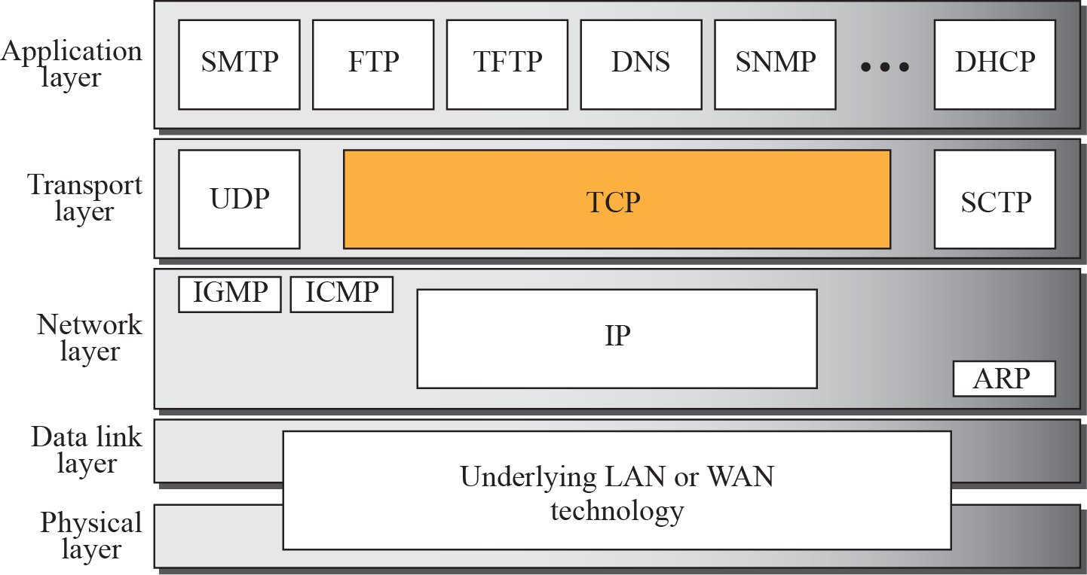
TCP/IP protocol suite

Slide 9
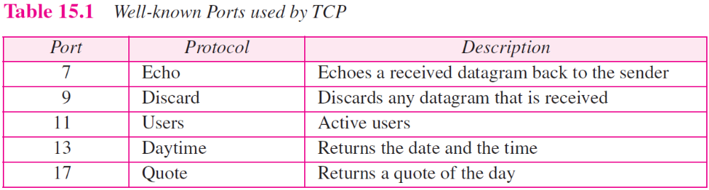
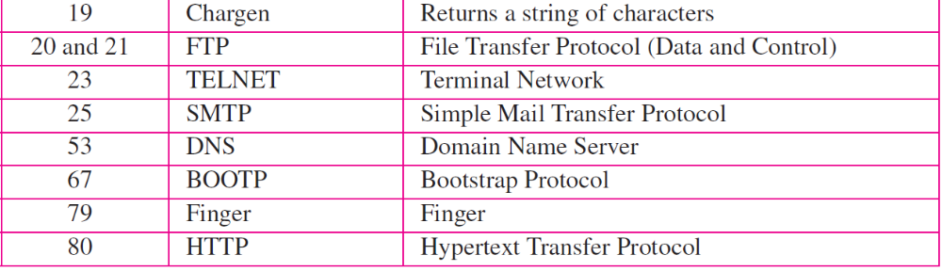

Slide 10
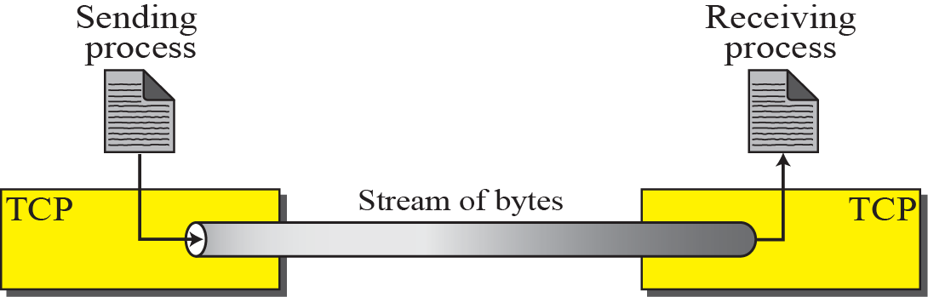
Stream delivery

Slide 11
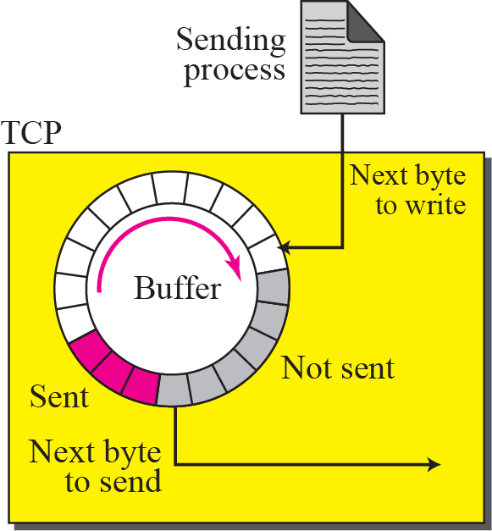
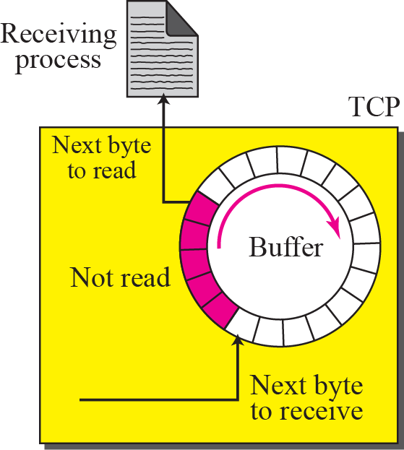
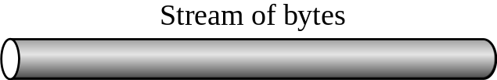
Sending and receiving buffers

Slide 12
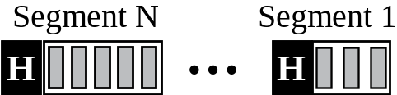
TCP segments

Slide 13
TCP FEATURES
To provide the services mentioned in the previous section, TCP has several features that are briefly summarized in this section and discussed later in detail.

Slide 14
Topics Discussed in the Section
Numbering System
Flow Control
Error Control
Congestion Control

Slide 15
SEGMENT
Before discussing TCP in more detail, let us discuss the TCP packets themselves. A packet in TCP is called a segment.
Topics Discussed in the Section
Format
Encapsulation

Slide 16
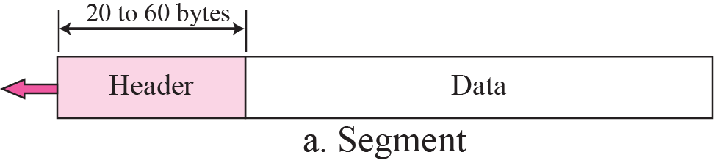
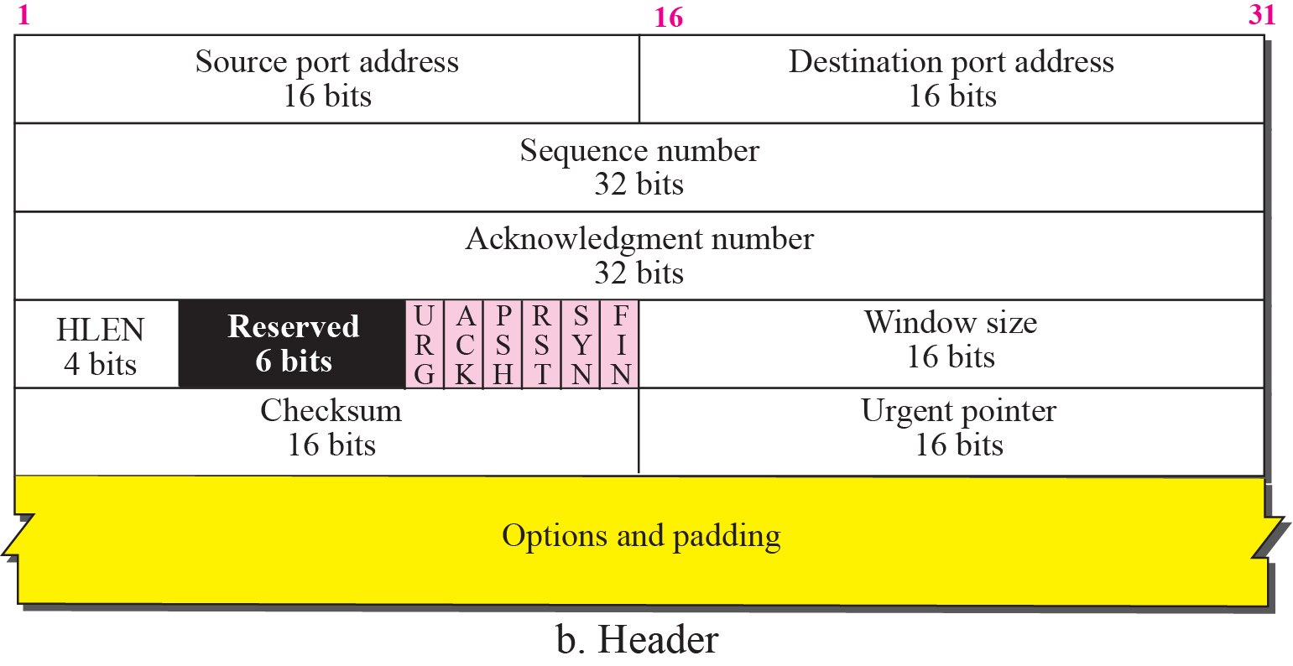
TCP segment format

Slide 17
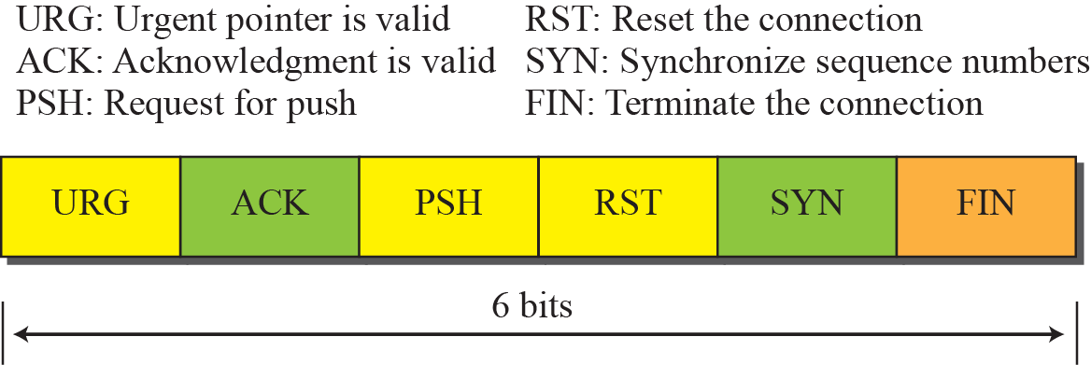
Control field

Slide 18
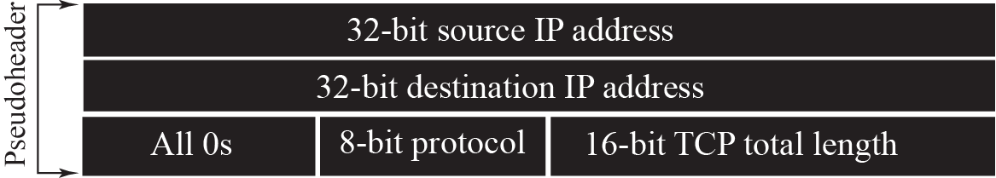
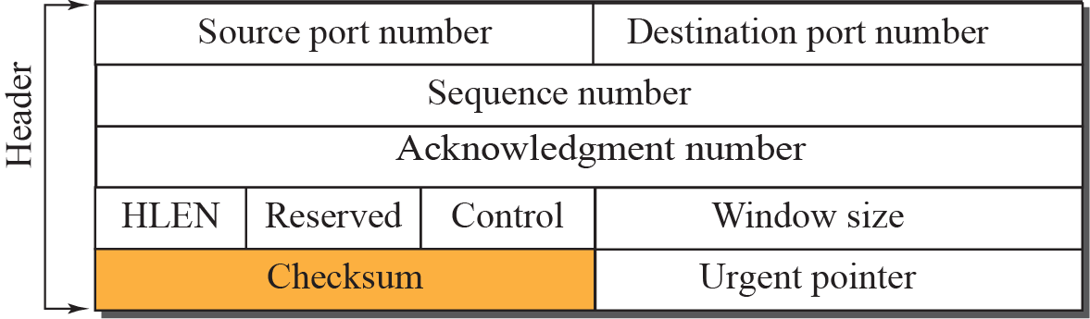

Pseudoheader added to the TCP segment

Slide 19
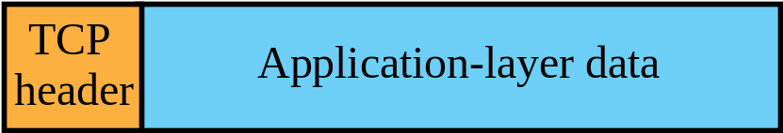
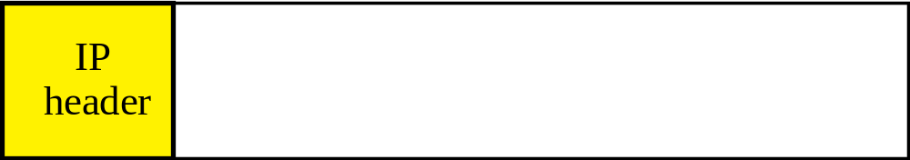
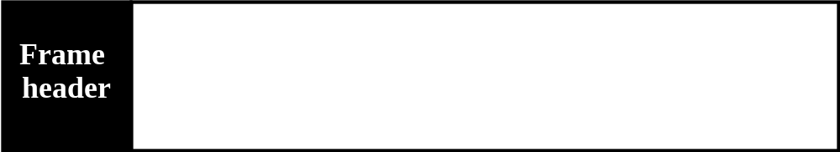
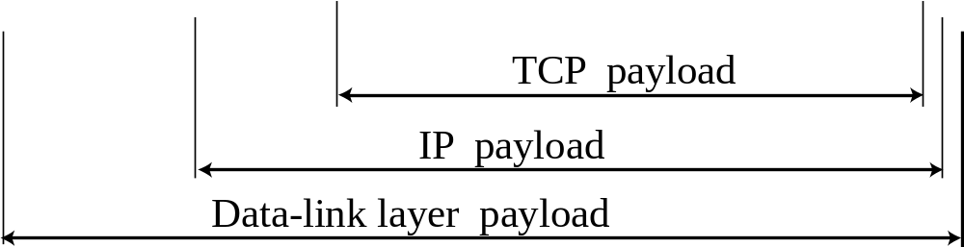
Encapsulation

Slide 20
A TCP CONNECTION
TCP is connection-oriented. It establishes a virtual path between the source and destination. All of the segments belonging to a message are then sent over this virtual path. You may wonder how TCP, which uses the services of IP, a connectionless protocol, can be connection-oriented. The point is that a TCP connection is virtual, not physical. TCP operates at a higher level. TCP uses the services of IP to deliver individual segments to the receiver, but it controls the connection itself. If a segment is lost or corrupted, it is retransmitted.

Slide 21
Topics Discussed in the Section
Connection Establishment
Data Transfer
Connection Termination
Connection Reset

Slide 22
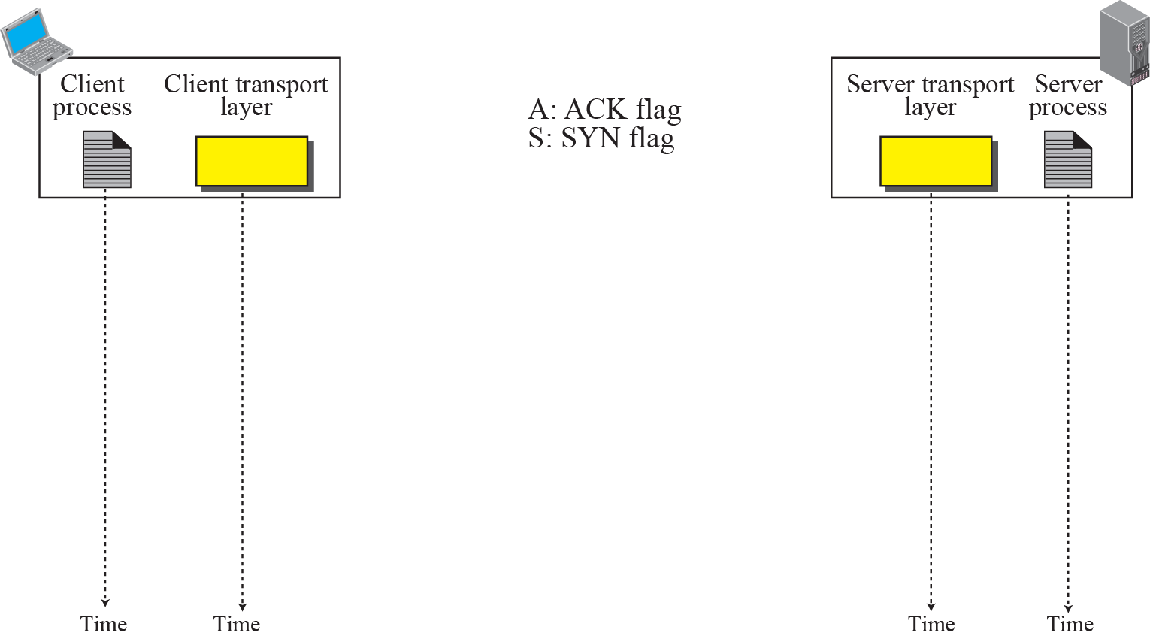
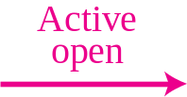
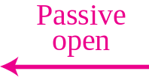
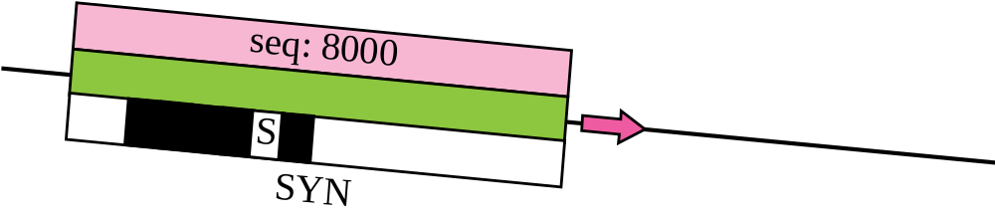
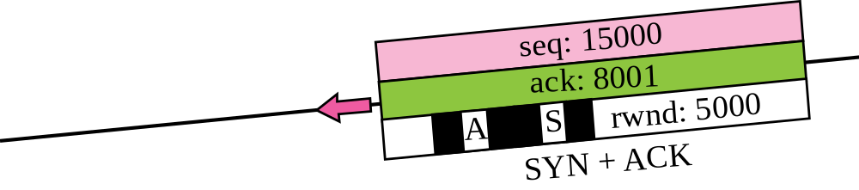
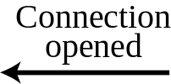
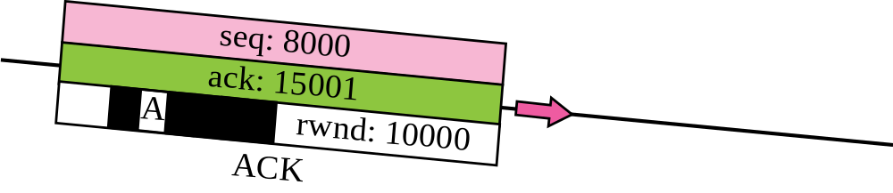

Connection establishment using three-way handshake
Means “no data” !
seq: 8001 if piggybacking

Slide 23
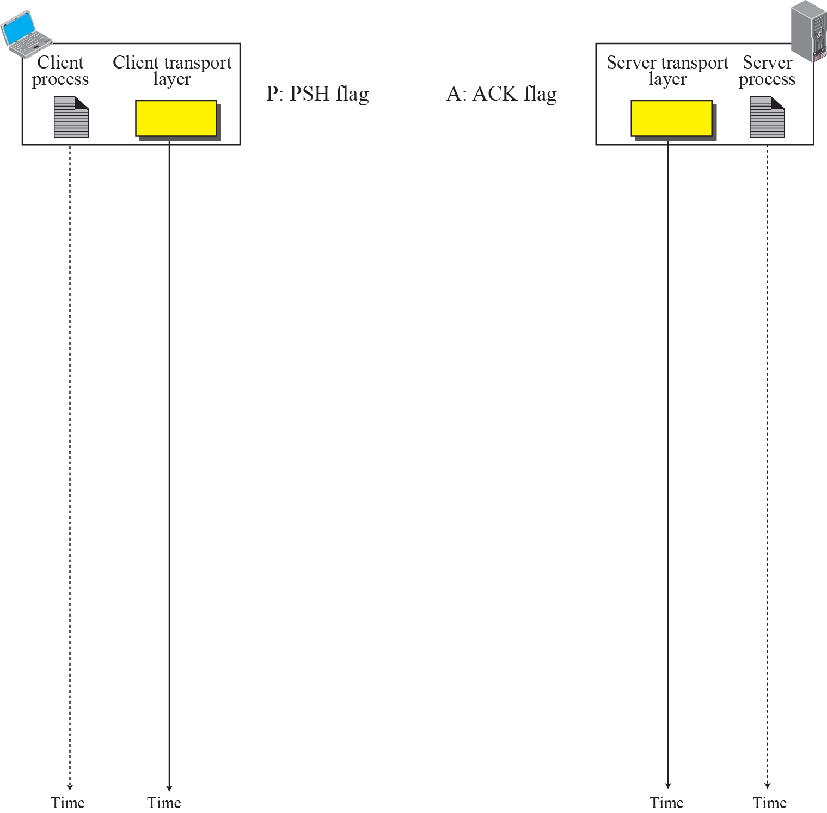
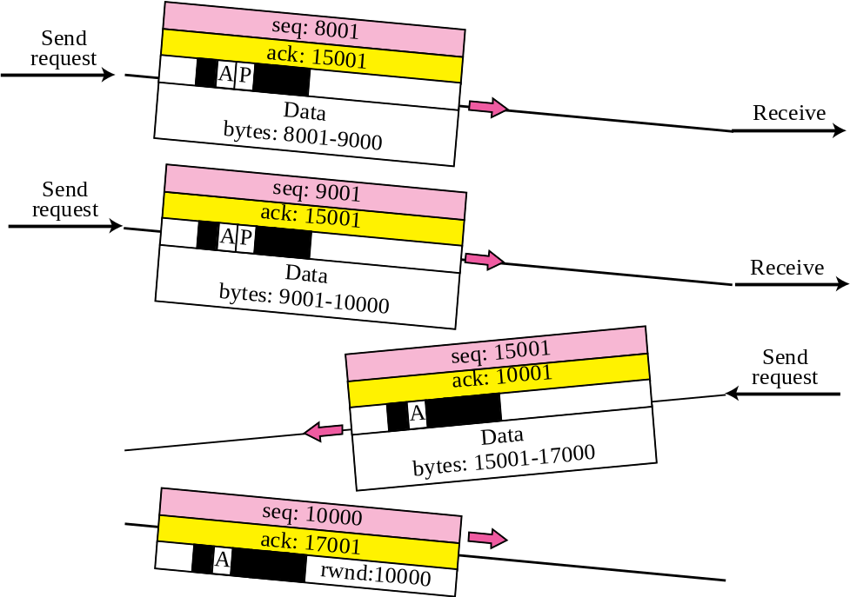

Data Transfer
Pushing data
Urgent data

Slide 24
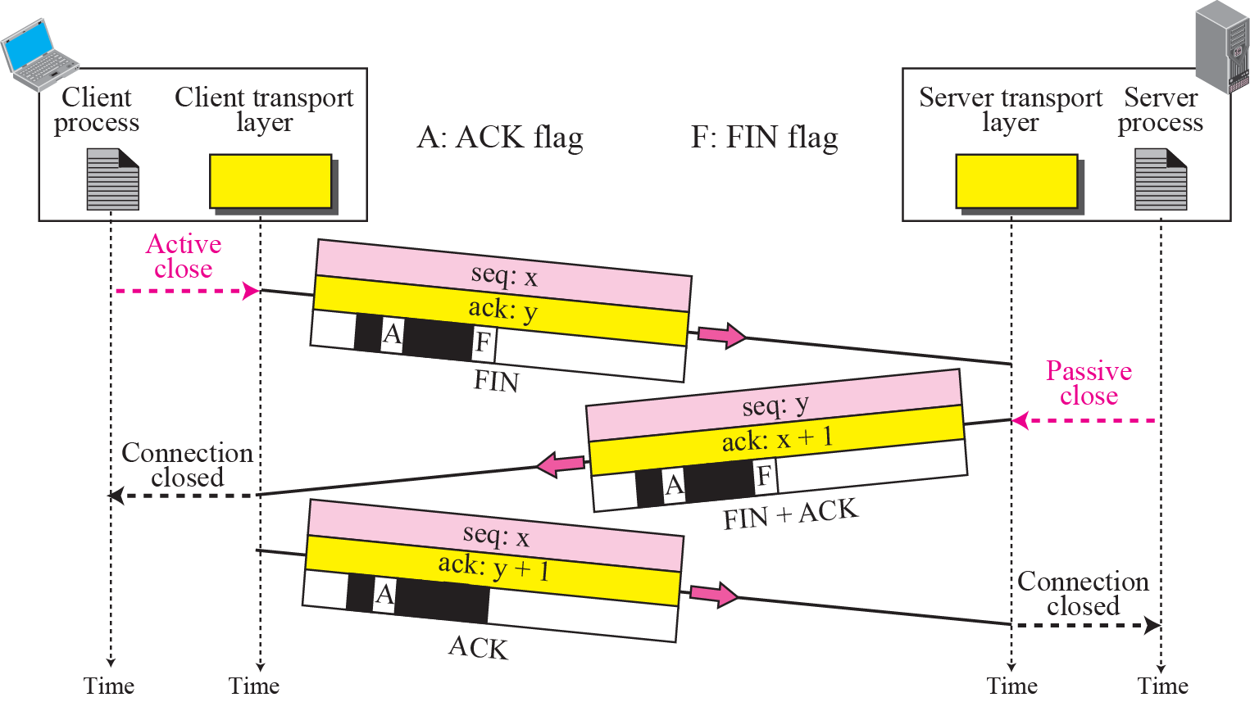
Connection termination using three-way handshake

Slide 25
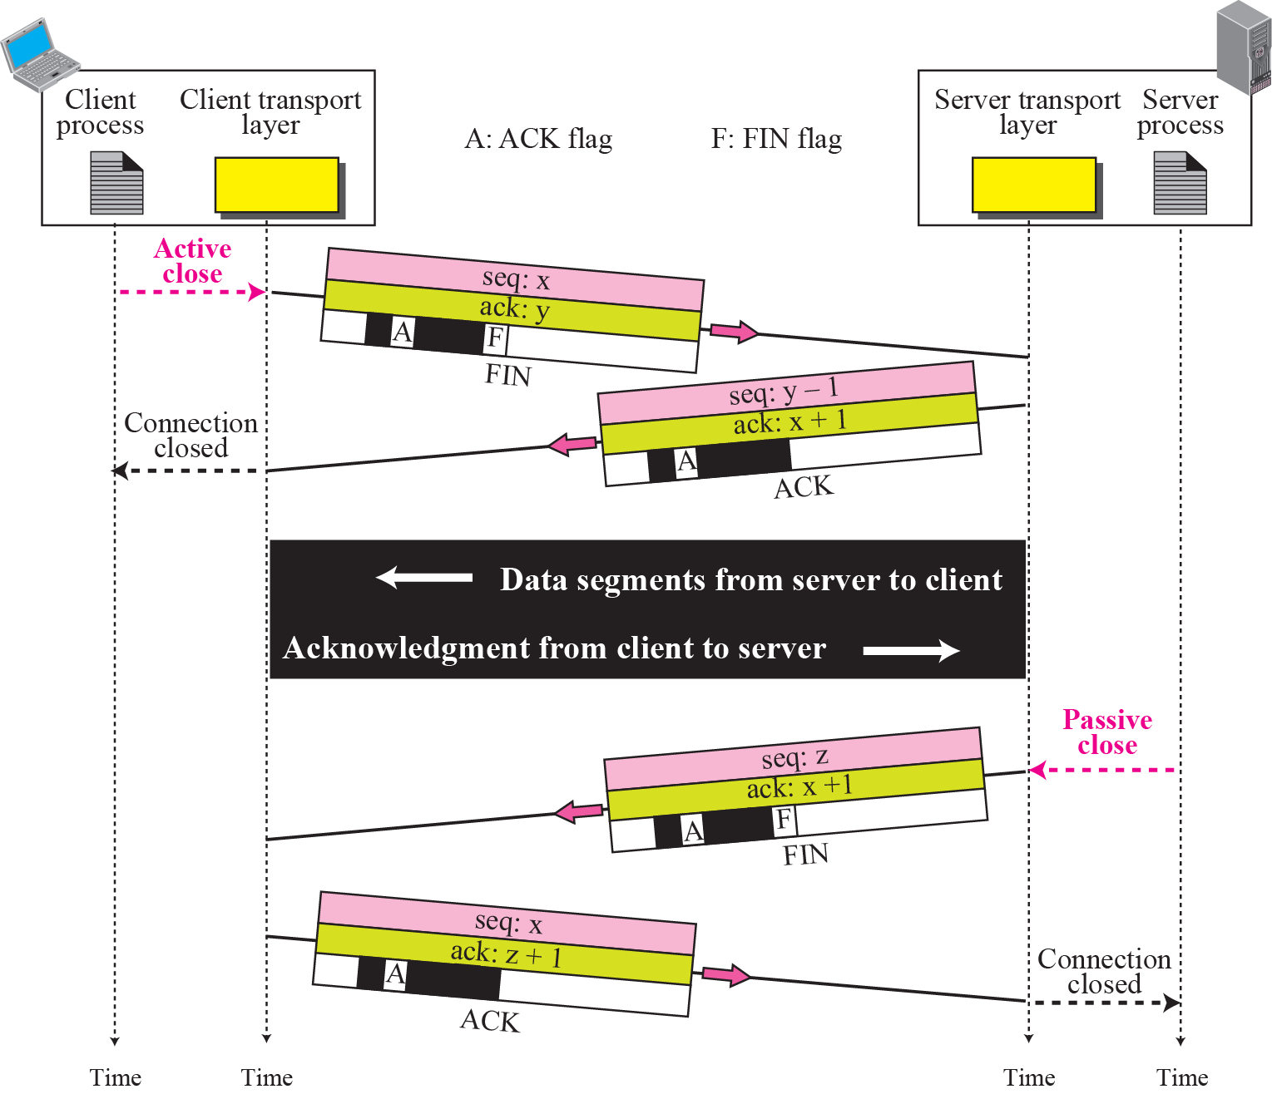
Half-Close

Slide 26
STATE TRANSITION DIAGRAM
To keep track of all the different events happening during connection establishment, connection termination, and data transfer, TCP is specified as the finite state machine shown in Figure

Slide 27
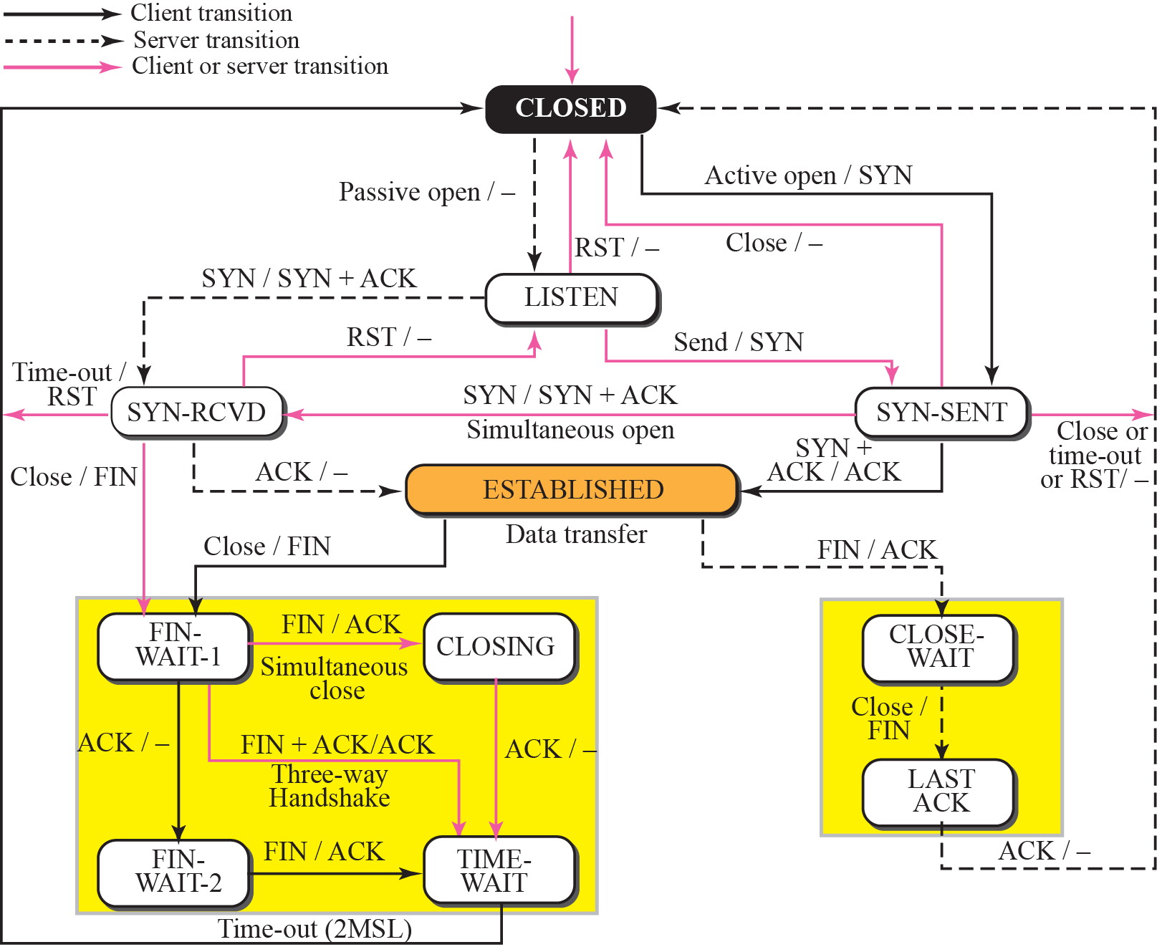
State transition diagram

Slide 28
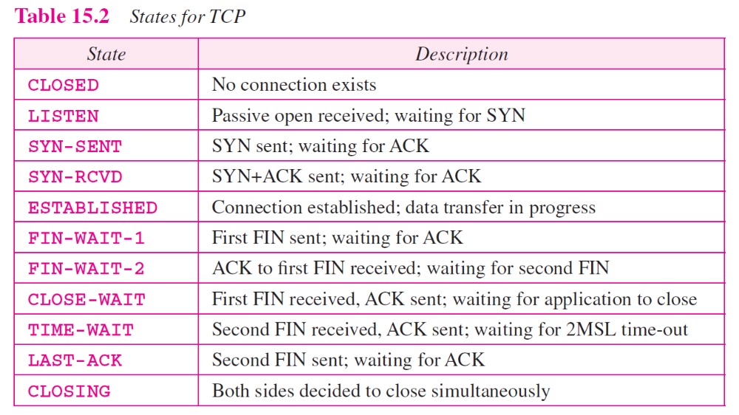

Slide 29
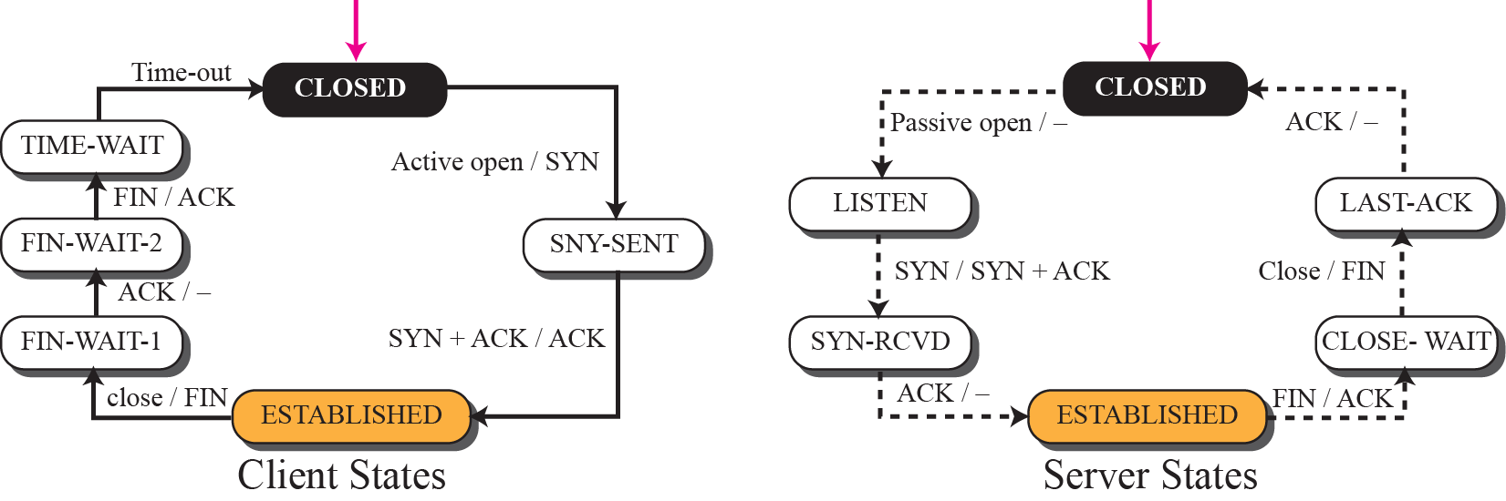
Transition diagram for connection and half-close termination

Slide 30
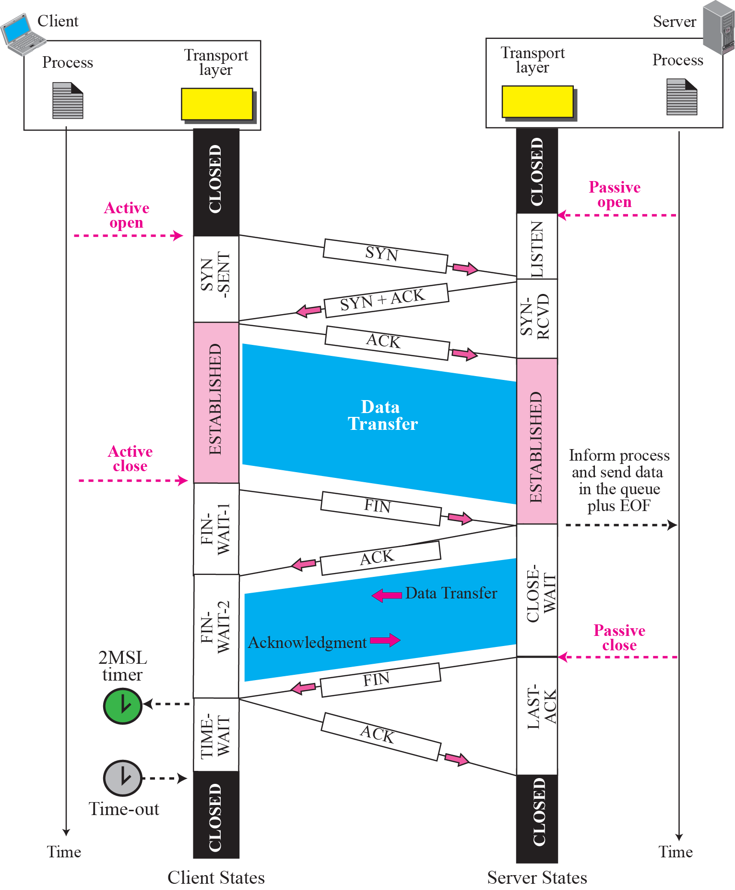
Time-line diagram for Figure 15.14
1. Enough time for an ACK to be lost and a new FIN to arrive. If during the TIME-WAIT state, a new FIN arrives, the client sends a new ACK and restarts the 2MSL timer
To prevent a duplicate segment from one connection appearing in the next one, TCP requires that incarnation cannot take place unless 2MSL amount of time has elapsed.
Another solution: the ISN of the incarnation is greater than the last seq. # used in the previous connection.

Slide 31
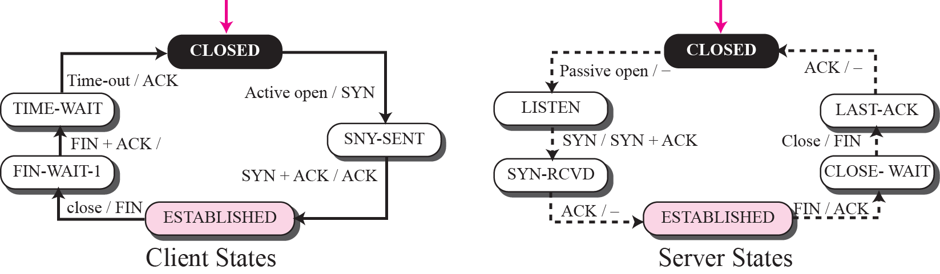
Transition diagram for a common scenario

Slide 32
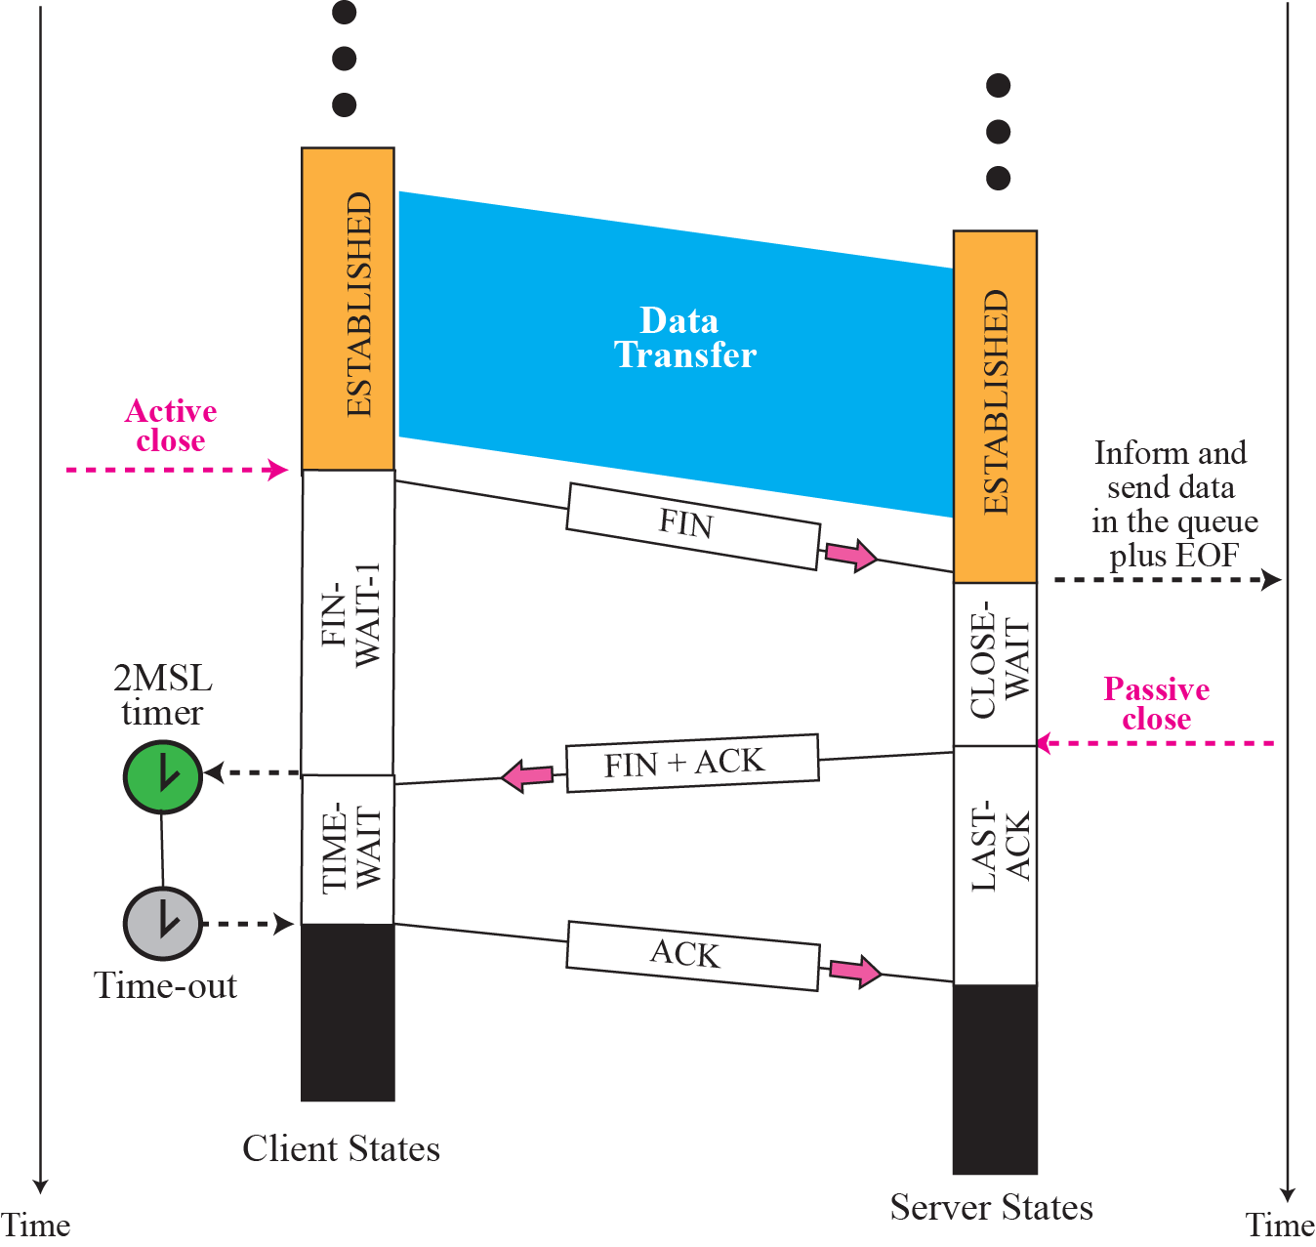
Time line for a common scenario

Slide 33
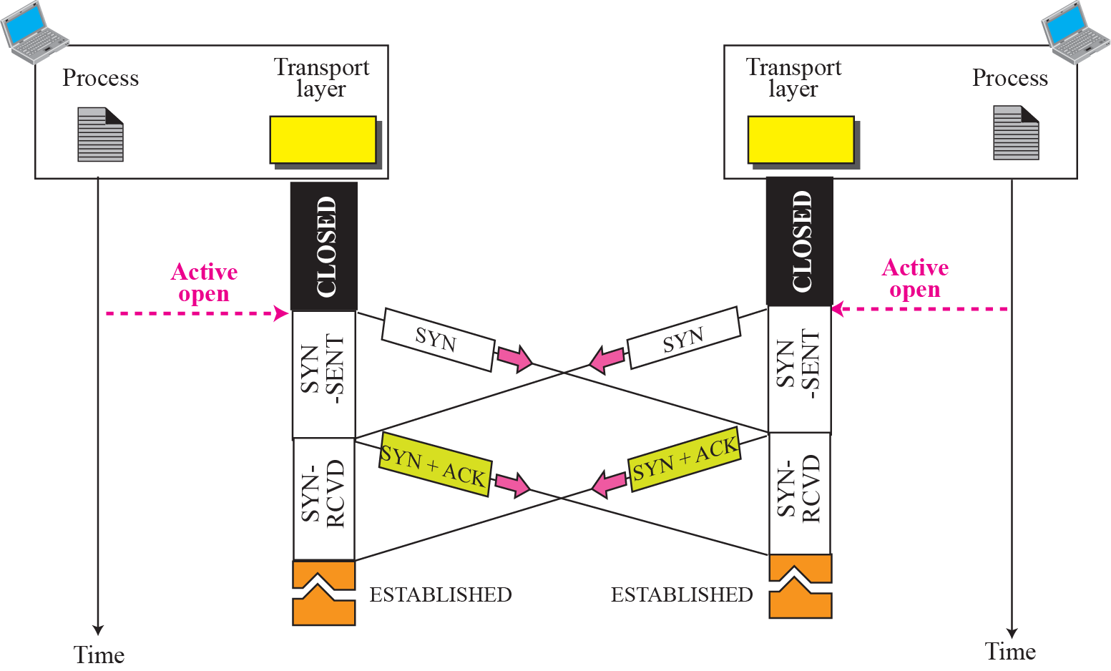
Simultaneous open

Slide 34
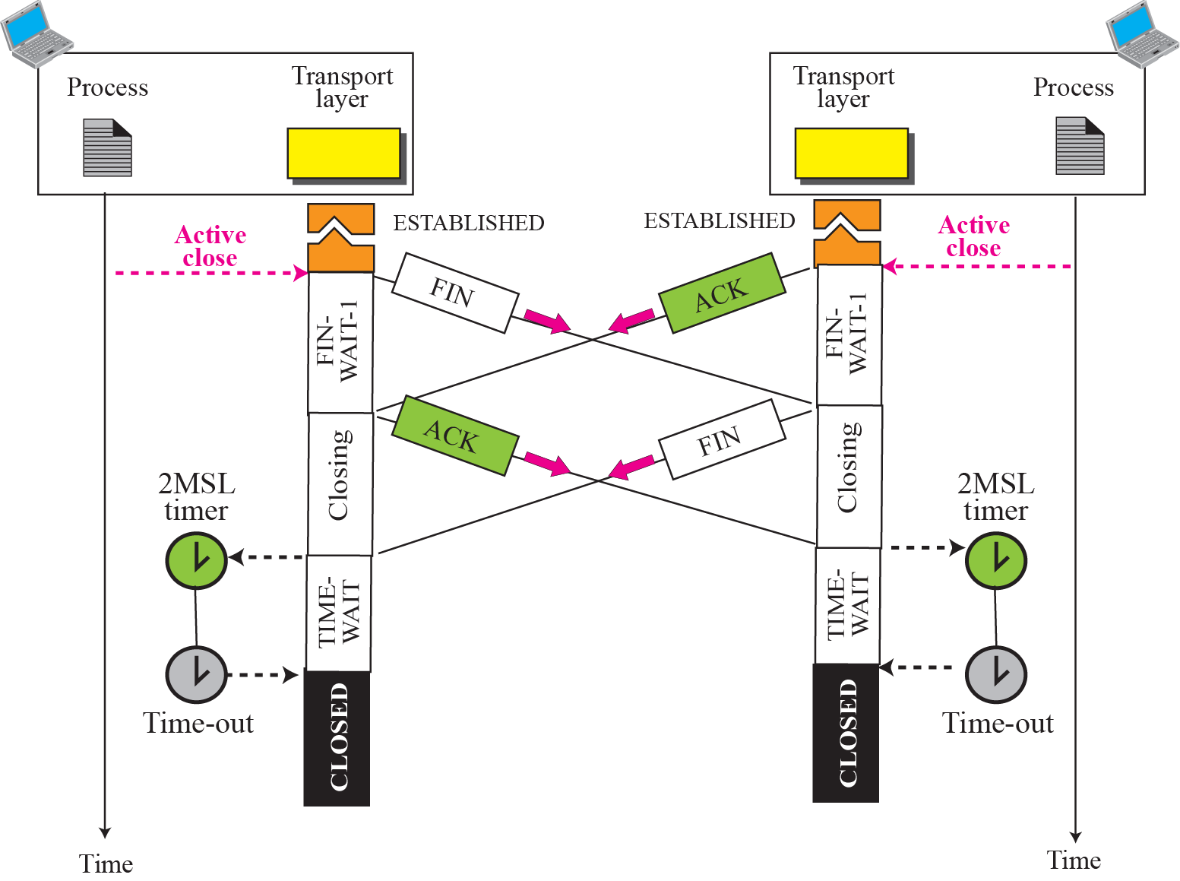
Simultaneous close
ex

Slide 35
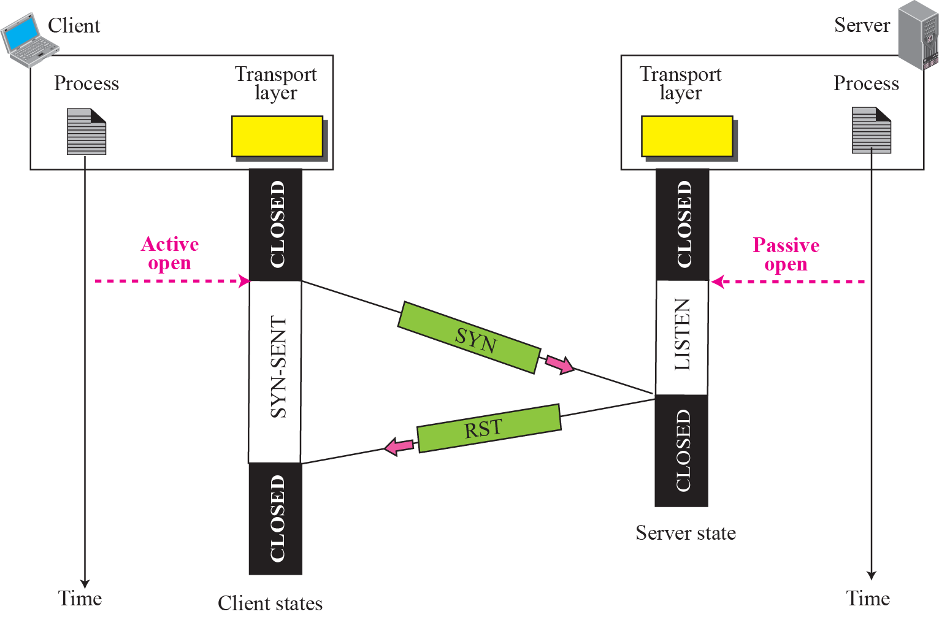
Denying a connection

Slide 36
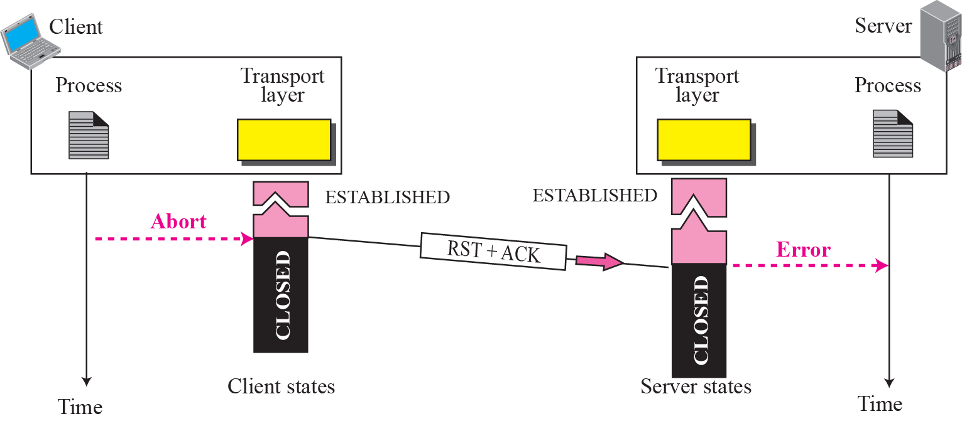
Aborting a connection

Slide 37
WINDOWS IN TCP
Before discussing data transfer in TCP and the issues such as flow, error, and congestion control, we describe the windows used in TCP. TCP uses two windows (send window and receive window) for each direction of data transfer, which means four windows for a bidirectional communication. To make the discussion simple, we make an assumption that communication is only unidirectional; the bidirectional communication can be inferred using two unidirectional communications with piggybacking.

Slide 38
Topics Discussed in the Section
Send Window
Receive Window

Slide 39
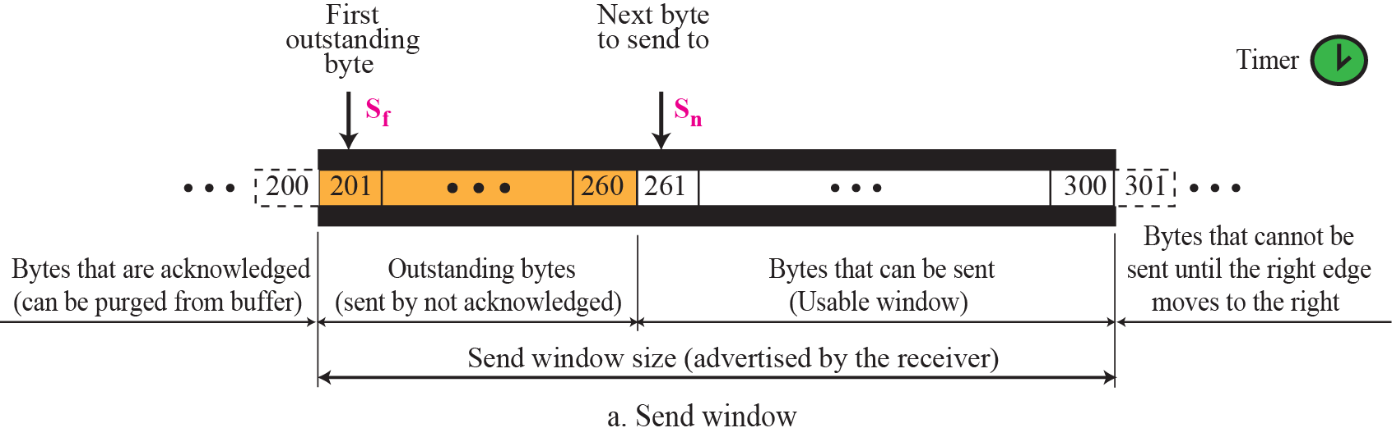
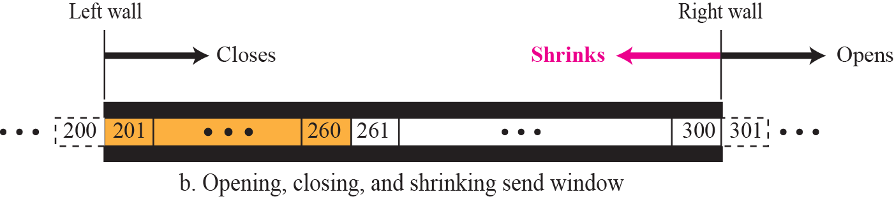
Send window in TCP

Slide 40
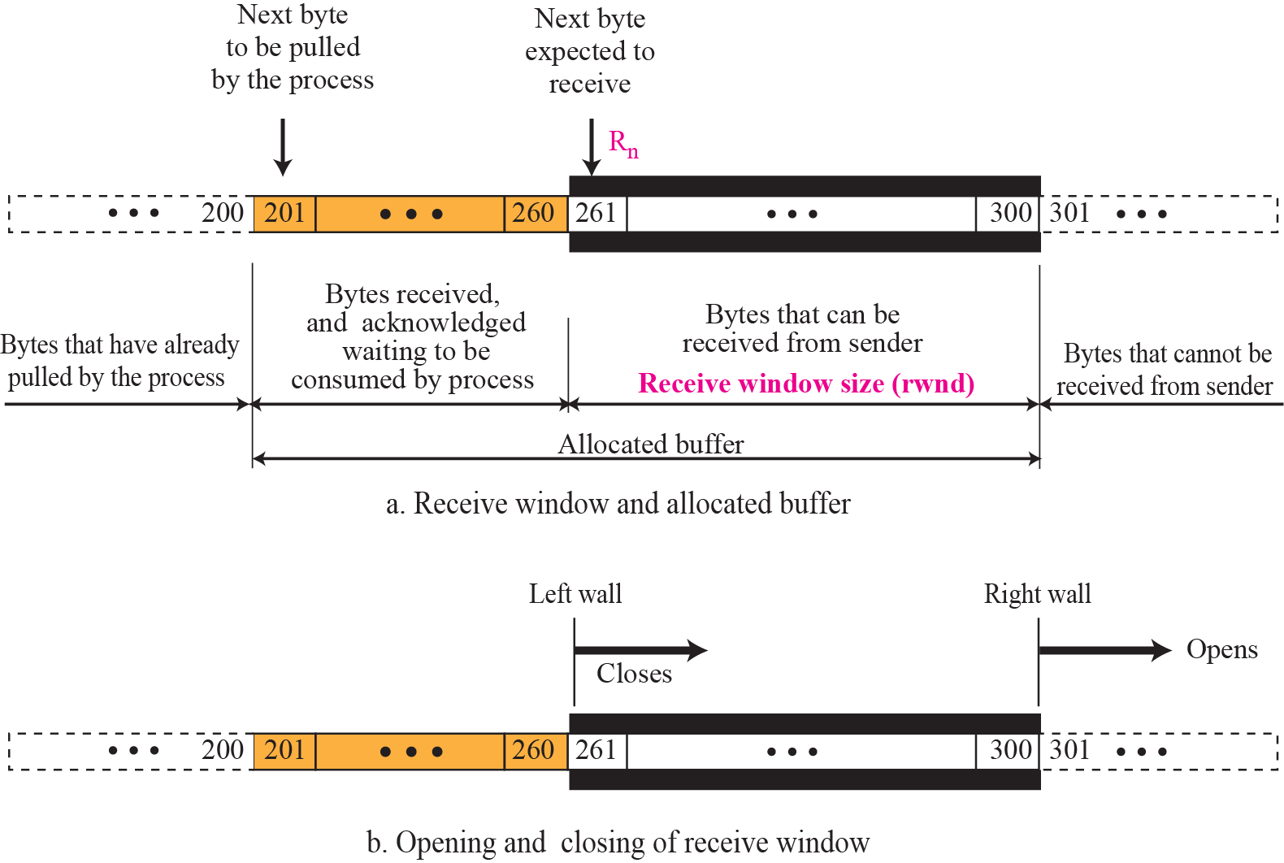
Receive window in TCP

Slide 41
FLOW CONTROL
As discussed in Chapter flow control balances the rate a producer creates data with the rate a consumer can use the data. TCP separates flow control from error control. In this section we discuss flow control, ignoring error control. We temporarily assume that the logical channel between the sending and receiving TCP is error-free. Figure shows unidirectional data transfer between a sender and a receiver; bidirectional data transfer can be deduced from unidirectional one as discussed

Slide 42
Topics Discussed in the Section
Opening and Closing Windows
Shrinking of Windows
Silly Window Syndrome

Slide 43
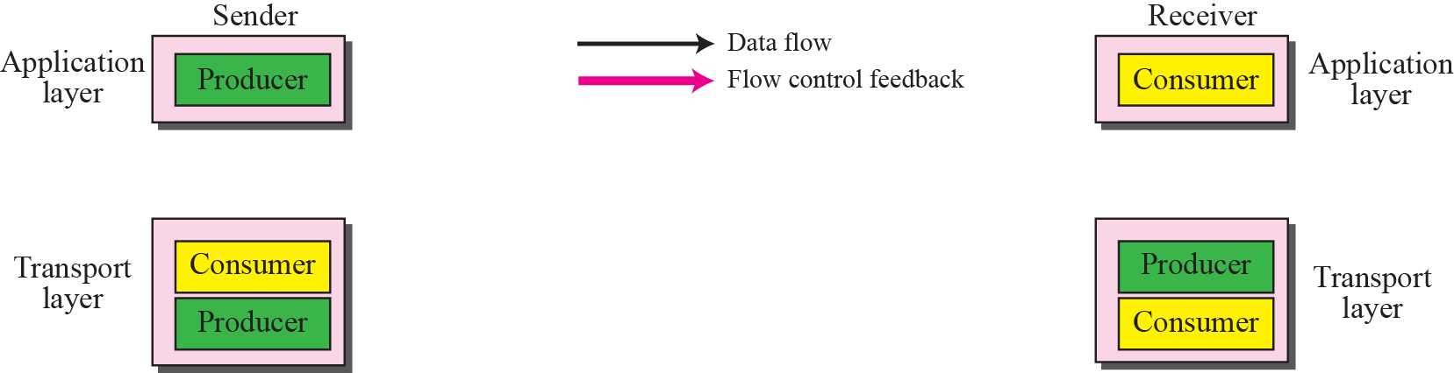
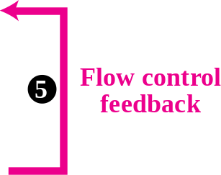
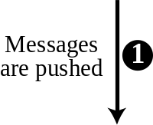
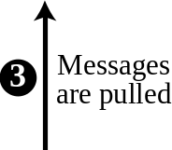
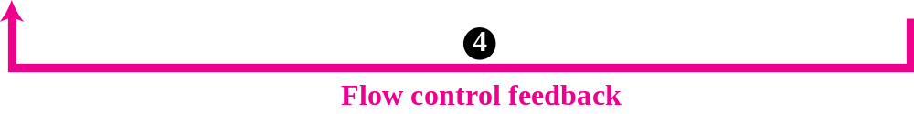
TCP/IP protocol suite

Slide 44
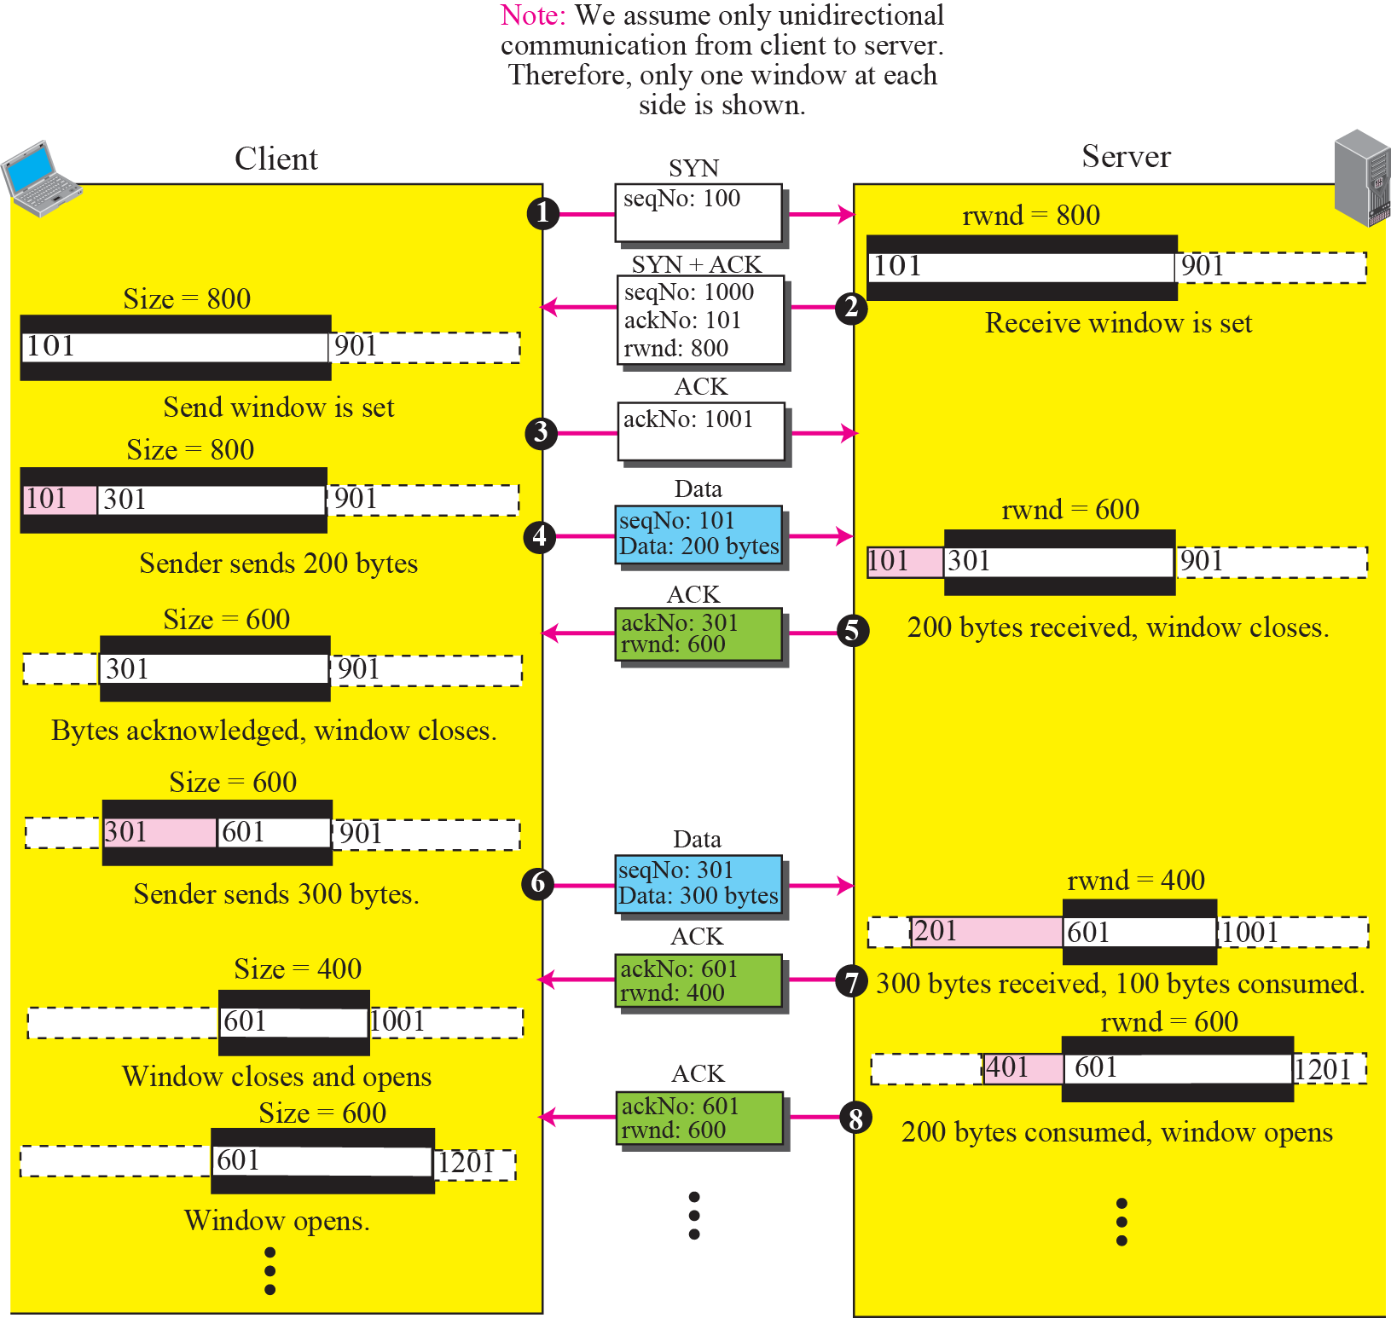
An example of flow control

Slide 45
Silly Window Syndrome (1)
Sending data in very small segments
Syndrome created by the Sender
  Sending application program creates data slowly (e.g. 1 byte at a time)
  Wait and collect data to send in a larger block
  How long should the sending TCP wait?
  Solution: Nagle’s algorithm
  Nagle’s algorithm takes into account (1) the speed of the application program that creates the data, and (2) the speed of the network that transports the data

Slide 46
Silly Window Syndrome (2)
Syndrome created by the Receiver
  Receiving application program consumes data slowly (e.g. 1 byte at a time)
  The receiving TCP announces a window size of 1 byte. The sending TCP sends only 1 byte…
  Solution 1: Clark’s solution
  Sending an ACK but announcing a window size of zero until there is enough space to accommodate a segment of max. size or until half of the buffer is empty

Slide 47
Silly Window Syndrome (3)
  Solution 2: Delayed Acknowledgement
  The receiver waits until there is decent amount of space in its incoming buffer before acknowledging the arrived segments
  The delayed acknowledgement prevents the sending TCP from sliding its window. It also reduces traffic.
  Disadvantage: it may force the sender to retransmit the unacknowledged segments
  To balance: should not be delayed by more than 500ms

Slide 48
ERROR CONTROL
TCP is a reliable transport layer protocol. This means that an application program that delivers a stream of data to TCP relies on TCP to deliver the entire stream to the application program on the other end in order, without error, and without any part lost or duplicated.
Error control in TCP is achieved through the use of three tools: checksum, acknowledgment, and time-out.

Slide 49
Topics Discussed in the Section
Checksum
Acknowledgment
Retransmission
Out-of-Order Segments
FSMs for Data Transfer in TCP
Some Scenarios

Slide 50
Acknowledgement Type
  In the past, TCP used only one type of acknowledgement: Accumulative Acknowledgement (ACK), also namely accumulative positive acknowledgement
  More and more implementations are adding another type of acknowledgement: Selective Acknowledgement (SACK), SACK is implemented as an option at the end of the TCP header.

Slide 51
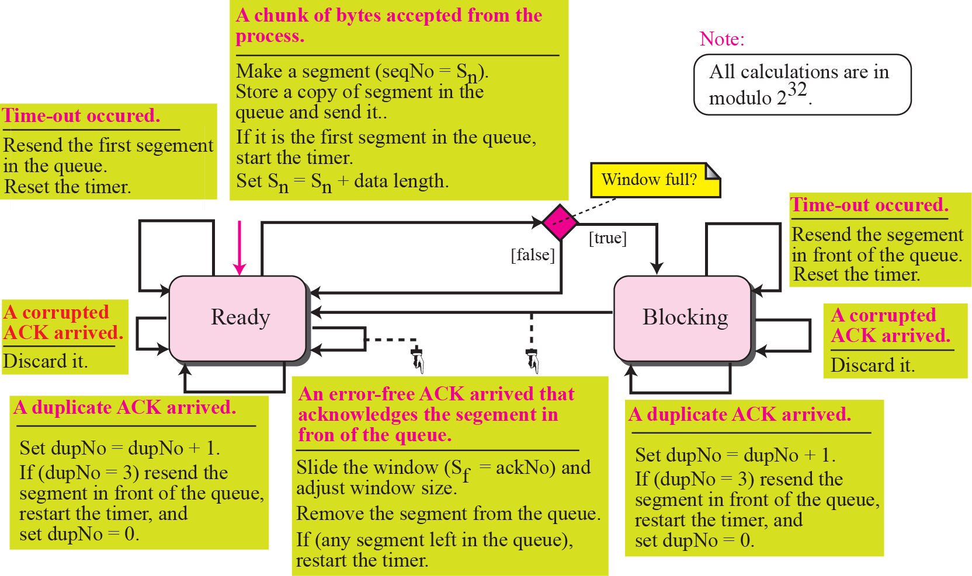
Simplified FSM for sender site

Slide 52
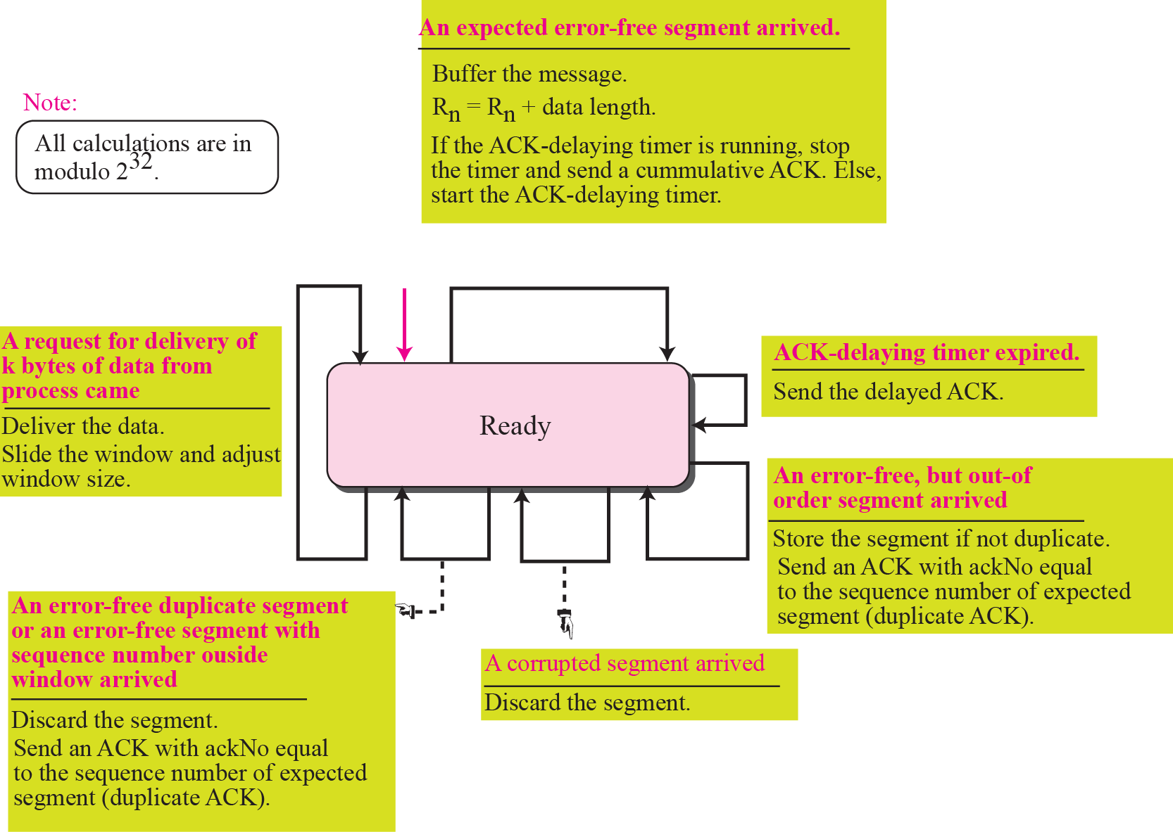
Simplified FSM for the receiver site

Slide 53
Rules for Generating ACK (1)
  1. When one end sends a data segment to the other end, it must include an ACK. That gives the next sequence number it expects to receive. (Piggyback)
  2. The receiver needs to delay sending (until another segment arrives or 500ms) an ACK segment if there is only one outstanding in-order segment. It prevents ACK segments from creating extra traffic.
  3. There should not be more than 2 in-order unacknowledged segments at any time. It prevent the unnecessary retransmission

Slide 54
Rules for Generating ACK (2)
  4. When a segment arrives with an out-of-order sequence number that is higher than expected, the receiver immediately sends an ACK segment announcing the sequence number of the next expected segment. (for fast retransmission)
  5. When a missing segment arrives, the receiver sends an ACK segment to announce the next sequence number expected.
  6. If a duplicate segment arrives, the receiver immediately sends an ACK.

Slide 55
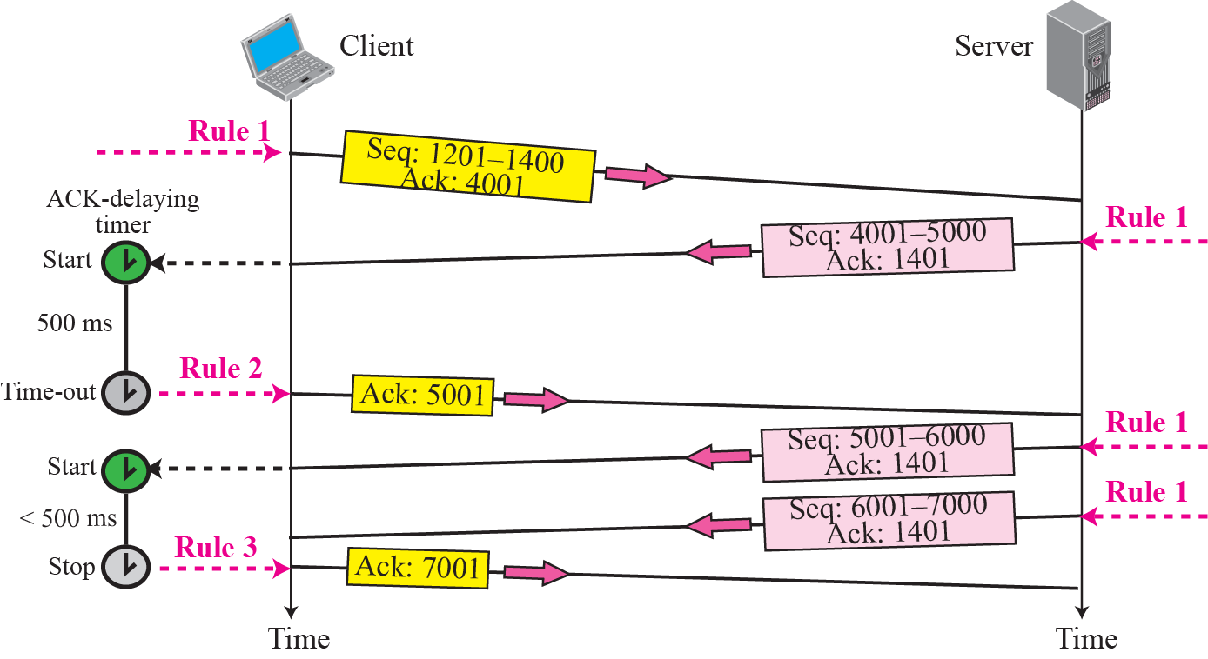
Normal operation

Slide 56

Lost segment

Slide 57






Fast retransmission

Slide 58

Lost acknowledgment

Slide 59

Lost acknowledgment corrected by resending a segment

Slide 60
CONGESTION CONTROL
Congestion control in TCP is based on both open loop and closed-loop mechanisms. TCP uses a congestion window and a congestion policy that avoid congestion and detect and alleviate congestion after it has occurred.

Slide 61
Topics Discussed in the Section
Congestion Window
Congestion Policy

Slide 62











Slow start, exponential increase

Slide 63

Congestion avoidance, additive increase

Slide 64

TCP Congestion policy summary

Slide 65

Congestion example

Slide 66
TCP TIMERS
To perform its operation smoothly, most TCP implementations use at least four timers as shown in Figure

Slide 67
Topics Discussed in the Section
Retransmission Timer
Persistence Timer
Keepalive Timer
TIME-WAIT Timer

Slide 68

TCP timers

Slide 69
Calculation of RTO (1)
Smoothed RTT: RTT_{S}
  Original → No value
  After 1st measurement → RTT_{S} = RTT_{M}
  2nd … → RTT_{S} = (1-α)*RTT_{S} + α*RTT_{M}
RTT Deviation : RTT_{D}
  Original → No value
  After 1st measurement → RTT_{D} = 0.5*RTT_{M}
  2nd … → RTT_{D} = (1-β)*RTT_{D} + β*|RTT_{S} - RTT_{M}|

Slide 70
Calculation of RTO (2)
Retransmission Timeout (RTO)
  Original → Initial value
  After any measurement
  → RTO = RTT_{S} + 4RTT_{D}
Example 10 (page 322)
  α = 1/8
  β = 1/4

Slide 71
OPTIONS
The TCP header can have up to 40 bytes of optional information. Options convey additional information to the destination or align other options. We can define two categories of options: 1-byte options and multiple-byte options. The first category contains two types of options: end of option list and no operation. The second category, in most implementations, contains five types of options: maximum segment size, window scale factor, timestamp, SACK-permitted, and SACK

Slide 72

Options

Slide 73

End-of-option option

Slide 74

No-operation option

Slide 75

Minimum-segment-size option

Slide 76

Window-scale-factor option

Slide 77

Timestamp option

Slide 78
TCP PACKAGE
The TCP header can have up to 40 bytes of optional information. Options convey additional information to the destination or align other options. We can define two categories of options: 1-byte options and multiple-byte options. The first category contains two types of options: end of option list and no operation. The second category, in most implementations, contains five types of options: maximum segment size, window scale factor, timestamp, SACK-permitted, and SACK

Slide 79
Topics Discussed in the Section
Transmission Control Block TCBs
Timers
Main Module
Input Processing Module
Output Processing Module

Slide 80

TCBs

Slide 81

TCP/IP protocol suite

Slide 82



Slide 83



Slide 84


Slide 85


Slide 86



Slide 87


Slide 88



Slide 89


