Slide 1




DEPARTMENT OF COMPUTER SCIENCE
AND ENGINEERING
NAME OF THE SUBJECT : Advanced Computer Networks
NAME OF THE TOPIC : Unit 4 – SCTP
PRESENTED BY :
Mr M Ch J Sekhar
Assistant Professor

Slide 2
Stream Control
Transmission Protocol
(SCTP)

Slide 3
OBJECTIVES:
To introduce SCTP as a new transport-layer protocol.
To discuss SCTP services and compare them with TCP.
To list and explain different packet types used in SCTP and discuss the purpose and of each field in each packet.
To discuss SCTP association and explain different scenarios such as association establishment, data transfer, association termination, and association abortion.
To compare and contrast the state transition diagram of SCTP with the corresponding diagram of TCP.
To explain flow control, error control, and congestion control mechanism in SCTP and compare them with the similar mechanisms in TCP.

Slide 4
Introduction
SCTP Services
STCP Features
Packet Format
An SCTP Association
State Transition Diagram
Flow Control
Error Control
Congestion Control

Slide 5
INTRODUCTION
Stream Control Transmission Protocol (SCTP) is a new reliable, message-oriented transport-layer protocol. Figure shows the relationship of SCTP to the other protocols in the Internet protocol suite. SCTP lies between the application layer and the network layer and serves as the intermediary between the application programs and the network operations.

Slide 6
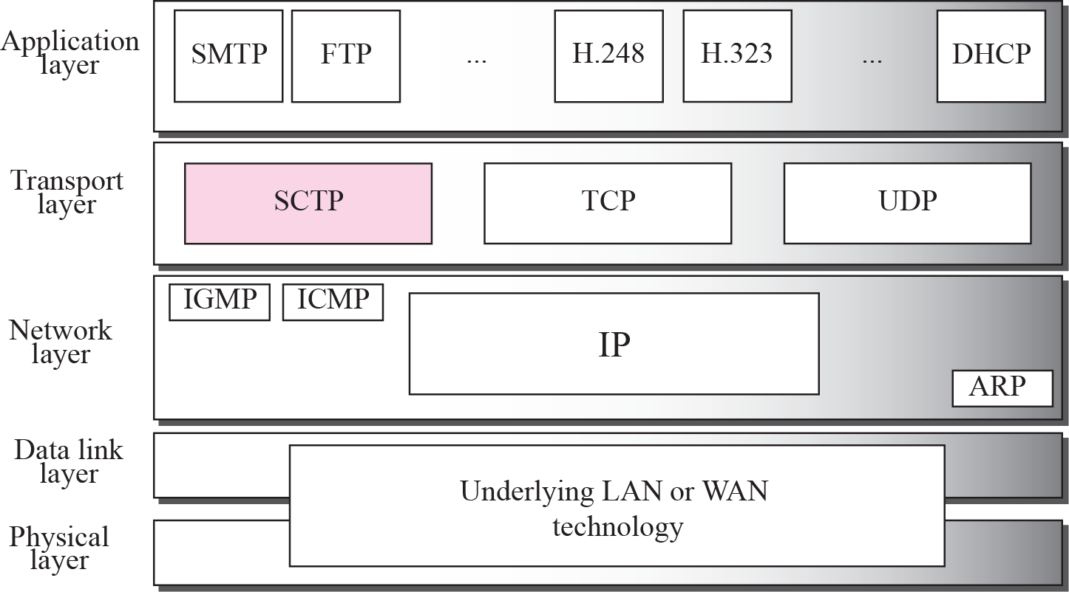
TCP/IP Protocol suite

Slide 7
SCTP SERVICES
Before discussing the operation of SCTP, let us explain the services offered by SCTP to the application layer processes.

Slide 8
Topics Discussed in the Section
Process-to-Process Communication
Multiple Streams
Multihoming
Full-Duplex Communication
Connection-Oriented Service
Reliable Service

Slide 9
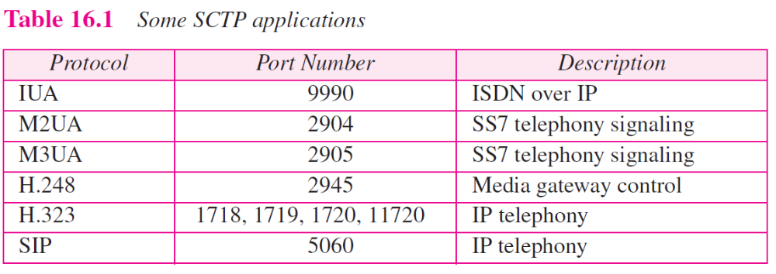

Slide 10
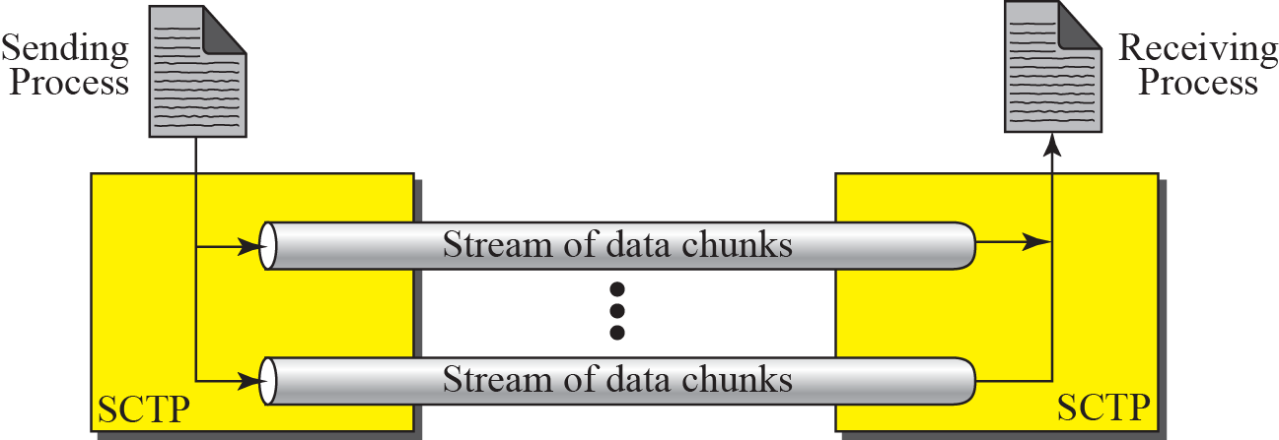
Multiple-stream concept
If one of the streams is blocked,
the other streams can still deliver
their data.

Slide 11
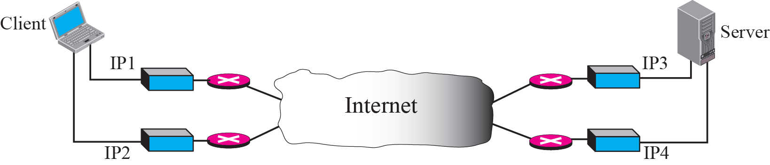
Multihoming concept
At present, SCTP does not allow load sharing between different path.
Currently, it is only for fault-tolerance.

Slide 12
Topics Discussed in the Section
Transmission Sequence Number (TSN)
Stream Identifier (SI)
Stream Sequence Number (SSN)
Packets
Acknowledgment Number
Flow Control
Error Control
Congestion Control

Slide 13
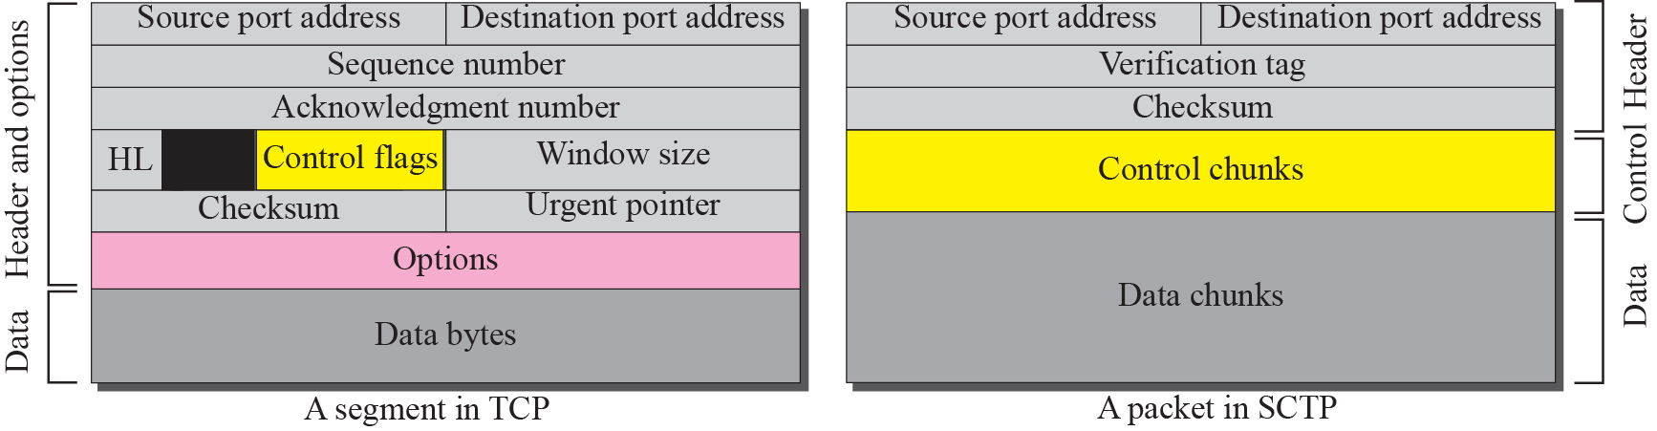
Comparison between a TCP segment and an SCTP packet

Slide 14
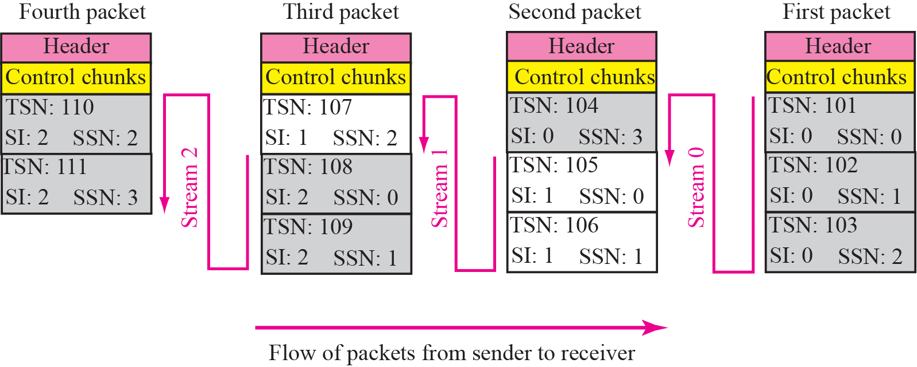
Packet, data chunks, and streams

Slide 15
PACKET FORMAT
In this section, we show the format of a packet and different types of chunks. Most of the information presented in this section will become clear later; this section can be skipped in the first reading or used only as the reference. An SCTP packet has a mandatory general header and a set of blocks called chunks. There are two types of chunks: control chunks and data chunks.

Slide 16
Topics Discussed in the Section
General Header
Chunks

Slide 17
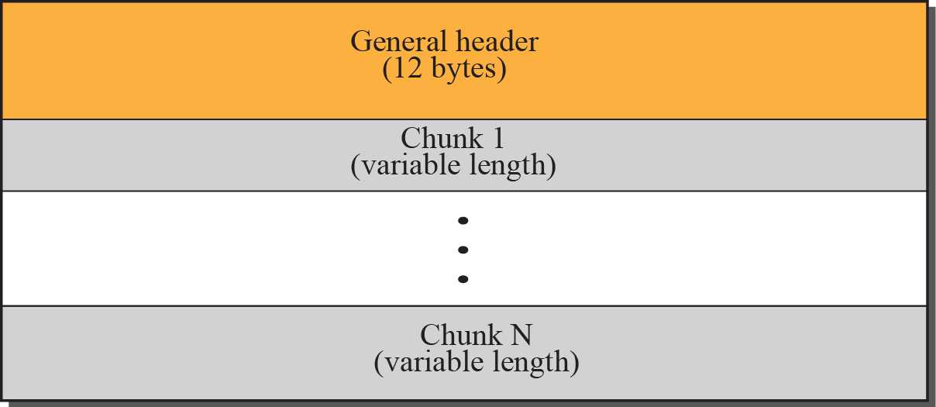
SCTP packet format

Slide 18
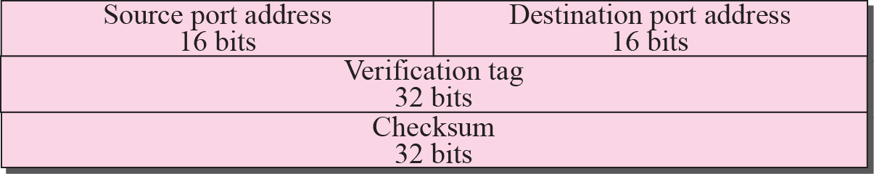
Common layout of a chunk

Slide 19
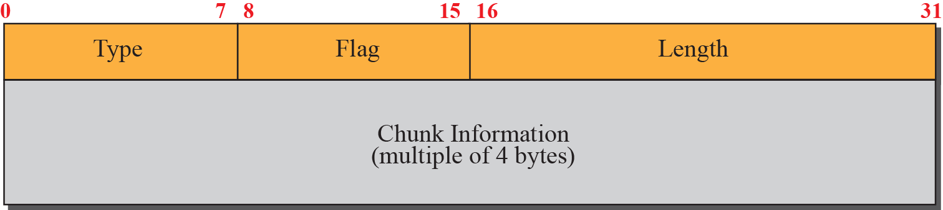
Multiple-stream concept

Slide 20
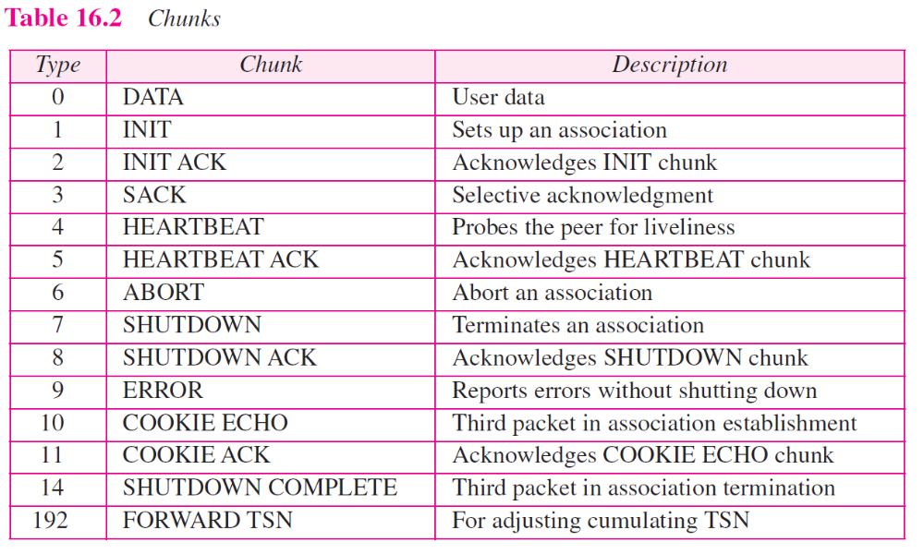

Slide 21
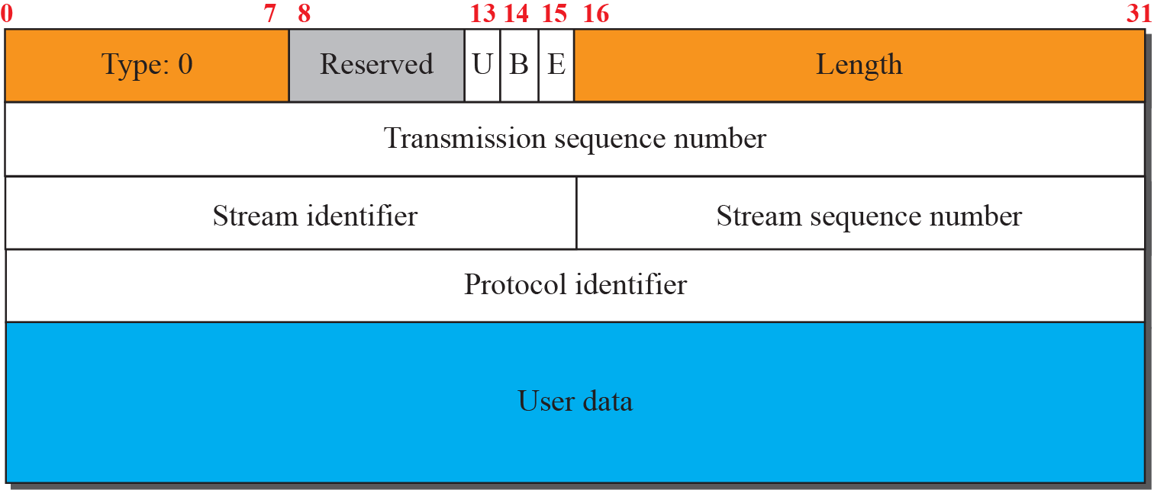
Data chunk

Slide 22
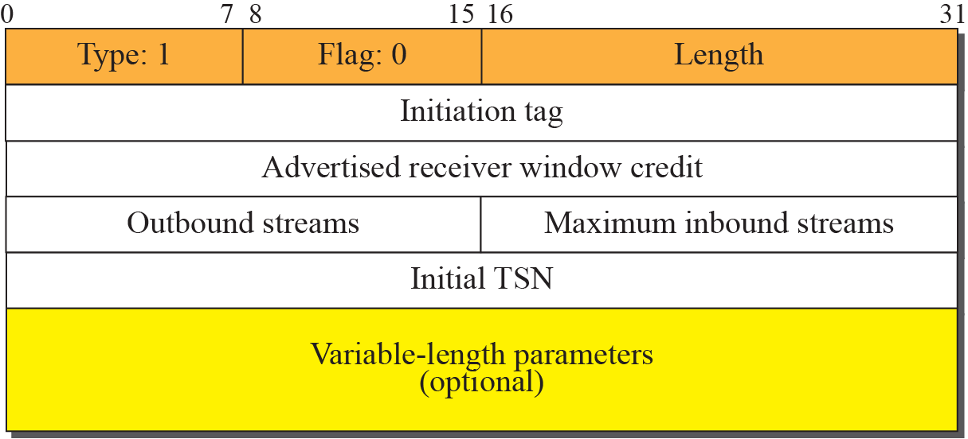
INIT chunk

Slide 23
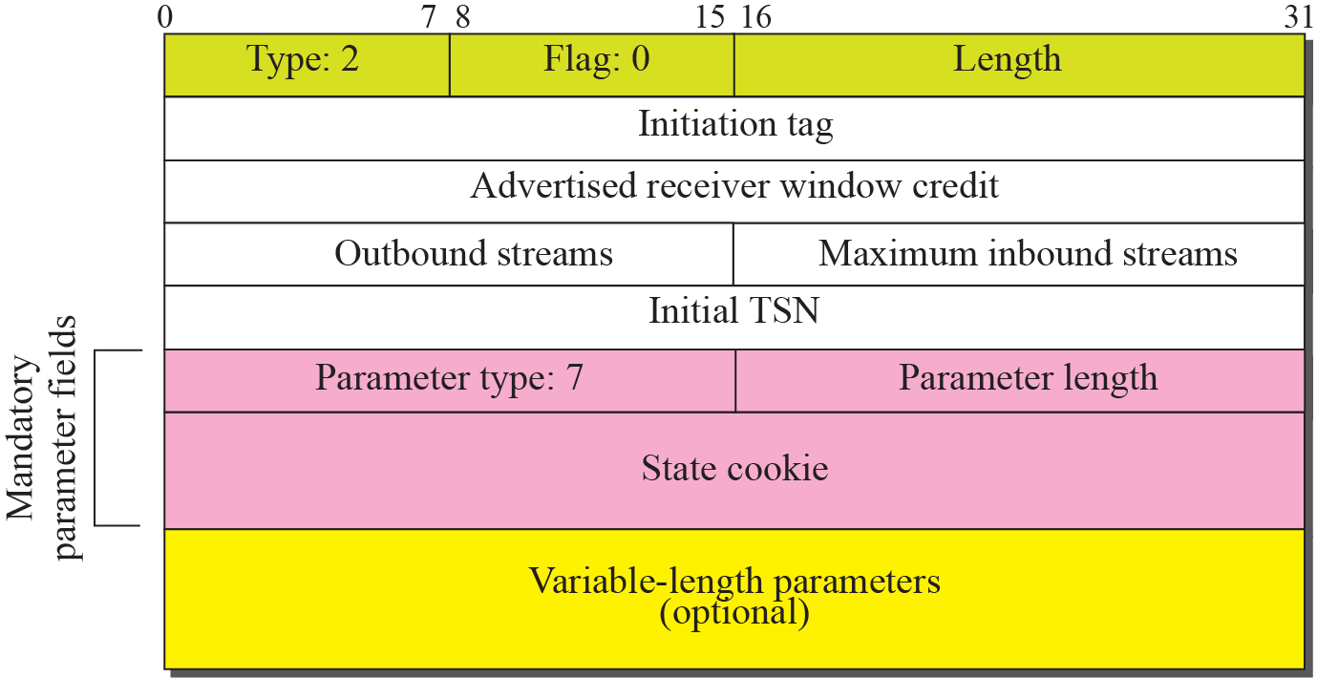
INIT ACK chunk

Slide 24
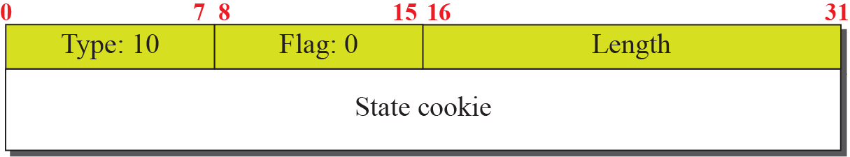
COOKIE ECHO chunk

Slide 25
COOKIE ACK

Slide 26
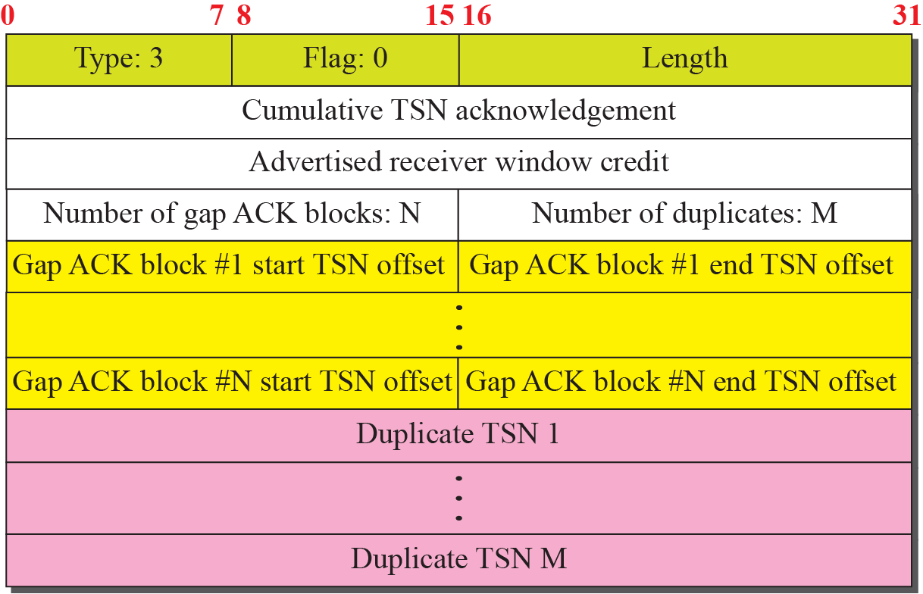
SACK chunk
The last data chunk received in sequence
The sequence of received chunks

Slide 27
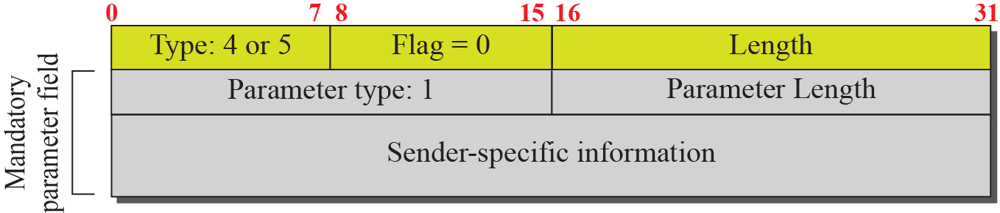
HEARTBEAT and HEARTBEAT ACK chunk
(Local time, Address of the sender)
Used to periodically probe the condition of an association

Slide 28
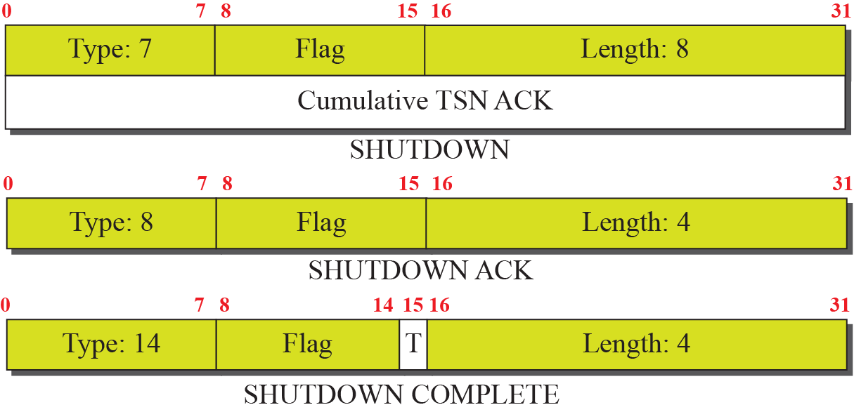
SHUTDOWN chunks

Slide 29
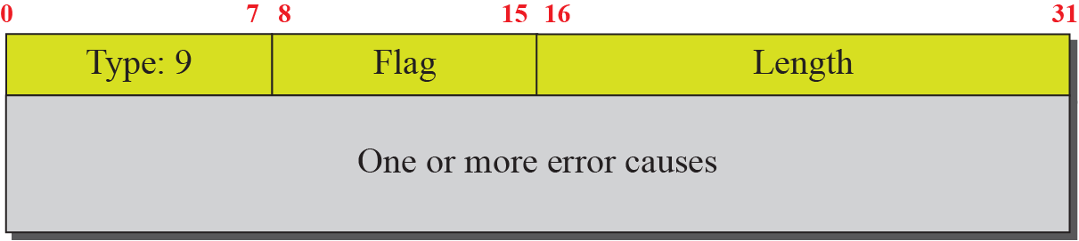
ERROR chunk
Sent when an end point finds some error in a received packet
But, which packet is with the error?

Slide 30
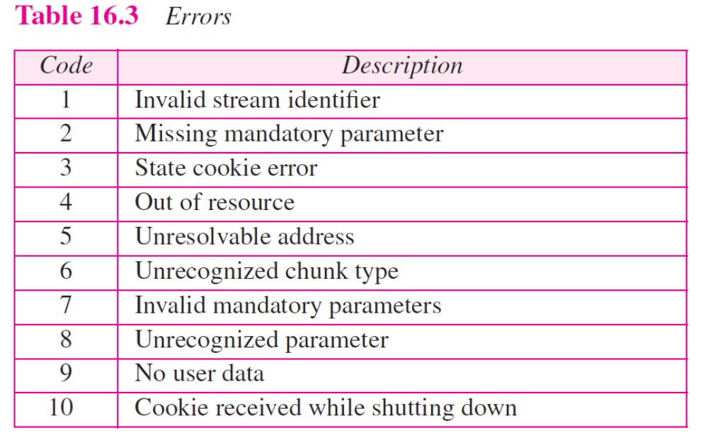

Slide 31
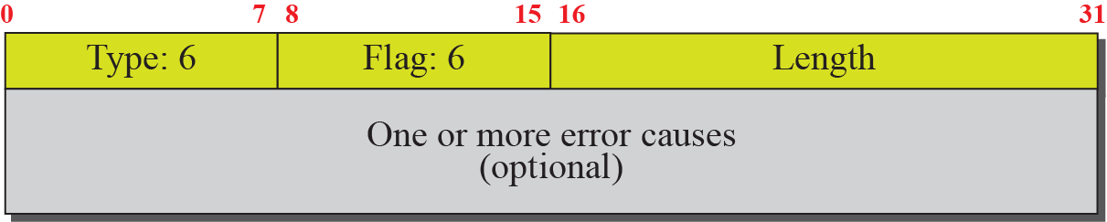
ABORT chunk

Slide 32
AN SCTP ASSOCIATION
SCTP, like TCP, is a connection-oriented protocol. However, a connection in SCTP is called an association to emphasize multihoming.

Slide 33
Topics Discussed in the Section
Association Establishment
Data Transfer
Association Termination
Association Abortion

Slide 34
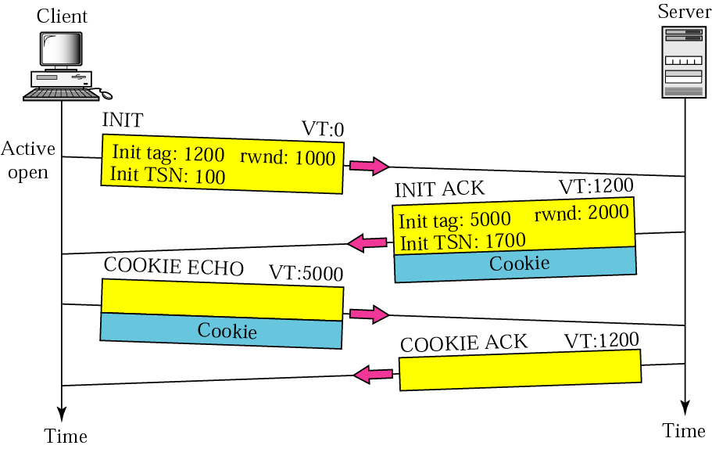
Four-way handshaking

Slide 35
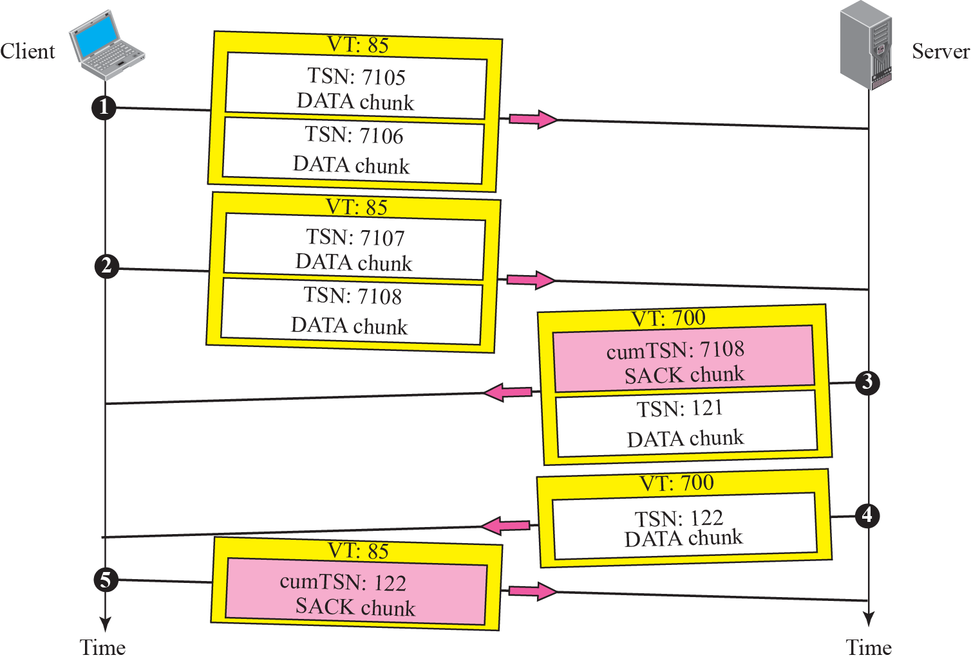
Simple data transfer

Slide 36
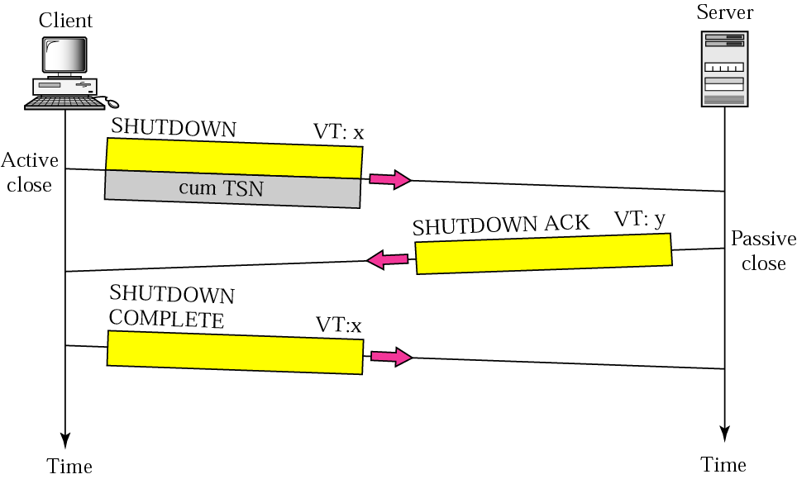
Association termination
SCTP does not allow a “half-closed” association
Flush leftover data

Slide 37
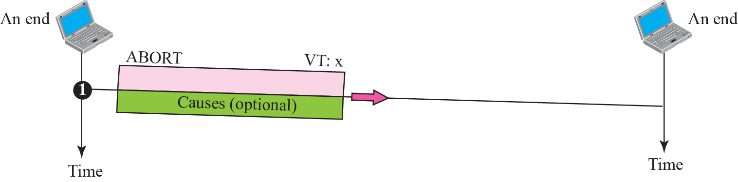
Association abortion

Slide 38
STATE TRANSITION DIAGRAM
To keep track of all the different events happening during association establishment, association termination, and data transfer, the SCTP software, like TCP, is implemented as a finite state machine. Figure 16.23 shows the state transition diagram for both client and server.

Slide 39
Topics Discussed in the Section
Scenarios

Slide 40
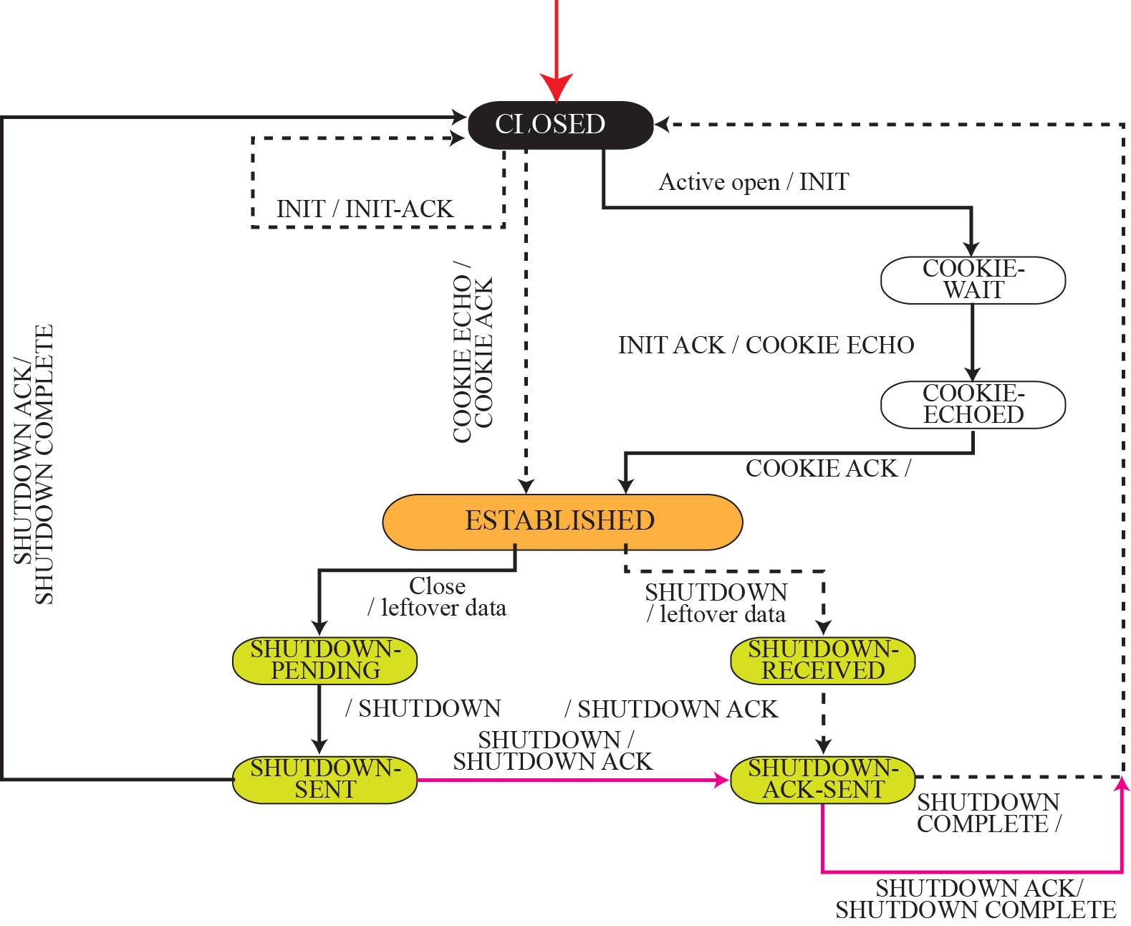
State transition diagram

Slide 41
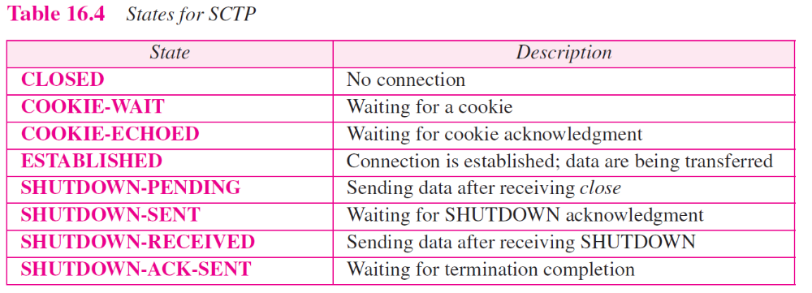

Slide 42
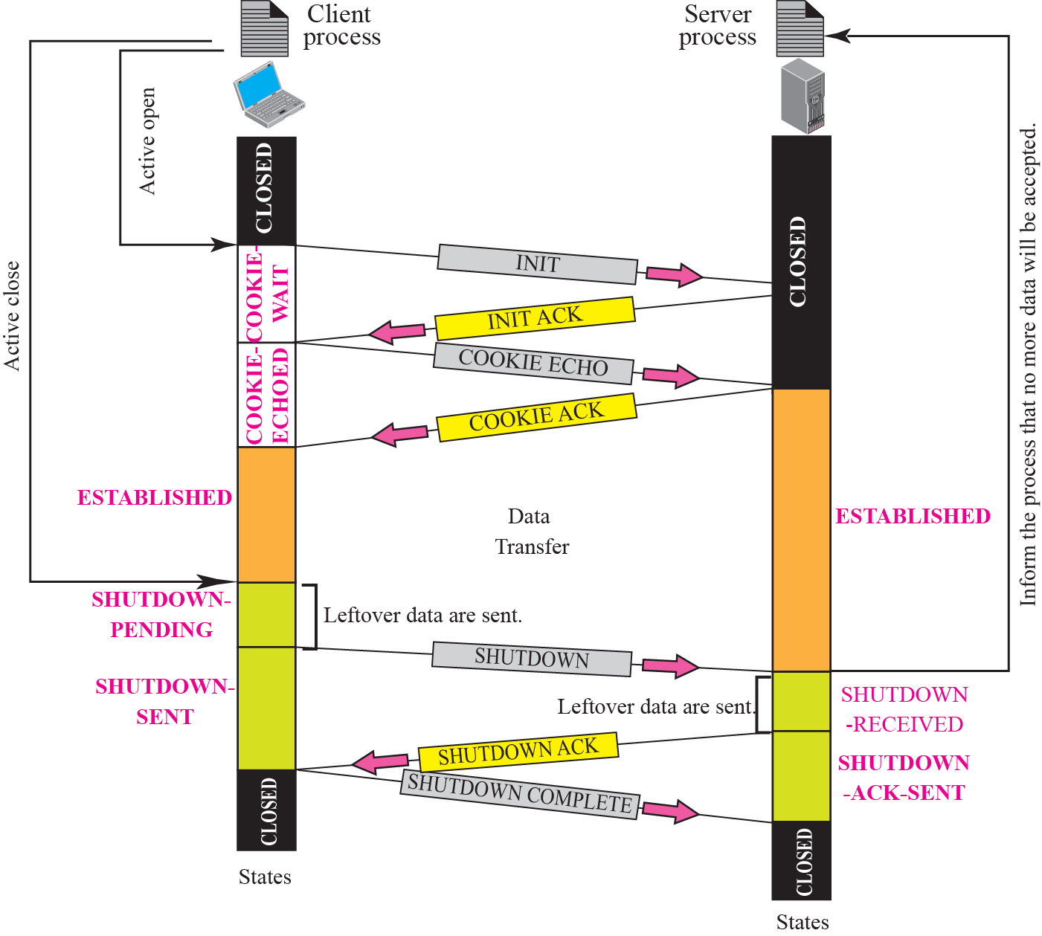
A common scenario of state

Slide 43
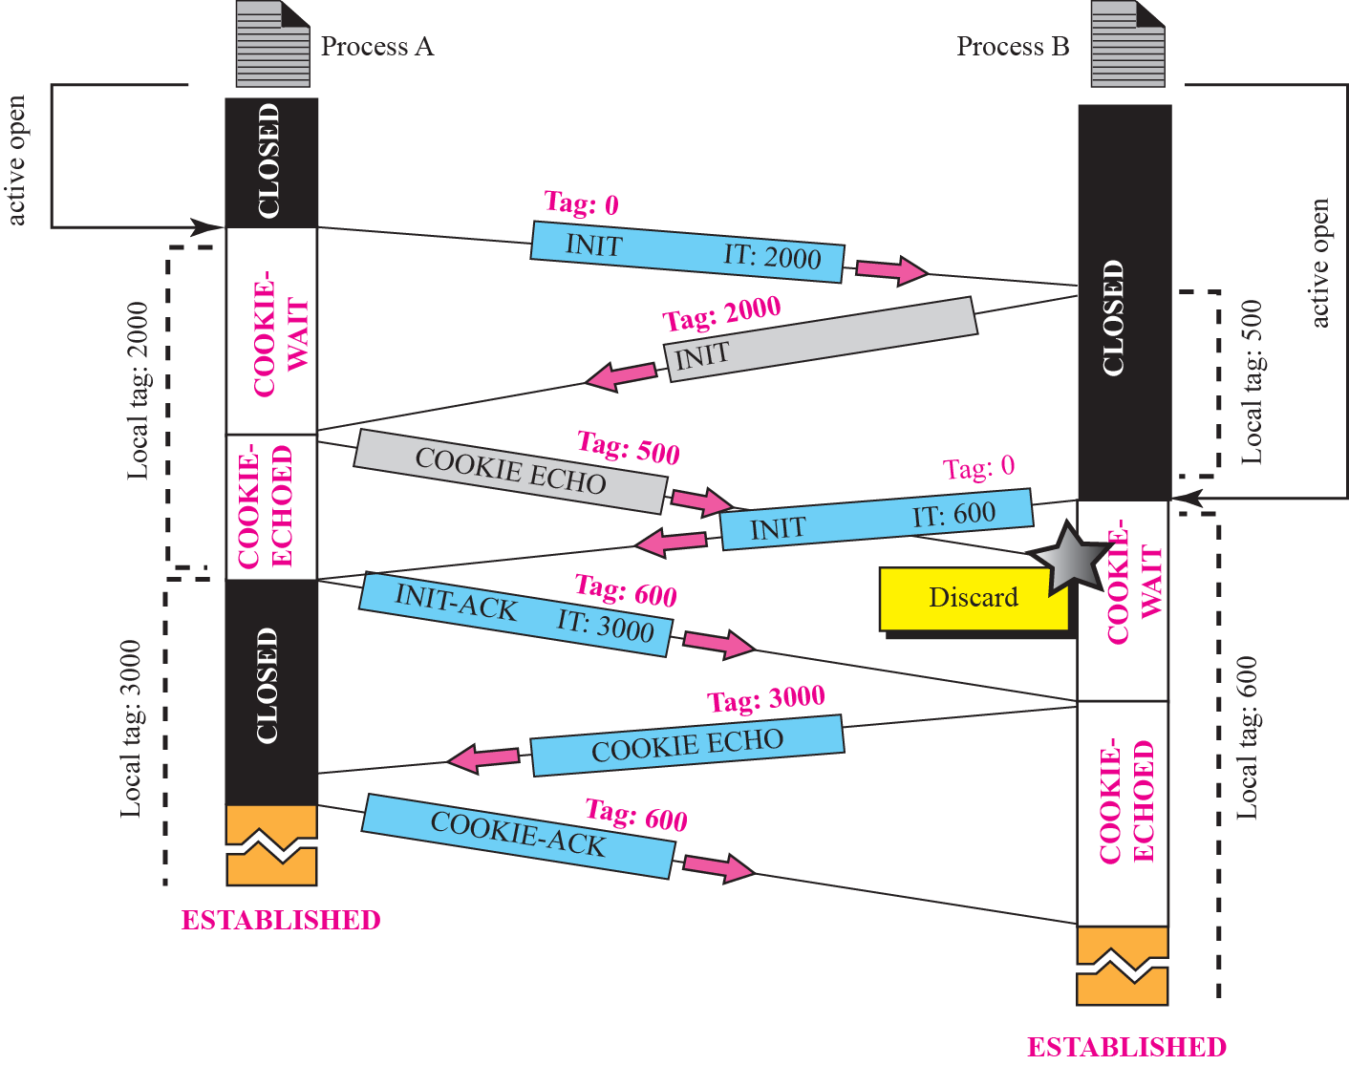
Simultaneous open
Each time a packet arrives with a verification tag that does not match the value of the local tag, it is discarded!

Slide 44
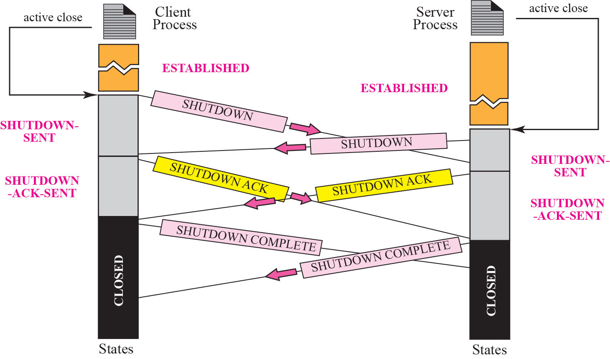
Simultaneous close

Slide 45
FLOW CONTROL
Flow control in SCTP is similar to that in TCP. In TCP, we need to deal with only one unit of data, the byte. In SCTP, we need to handle two units of data, the byte and the chunk. The values of rwnd and cwnd are expressed in bytes; the values of TSN and acknowledgments are expressed in chunks.

Slide 46
Topics Discussed in the Section
Receiver Site
Sender Site
A Scenario

Slide 47
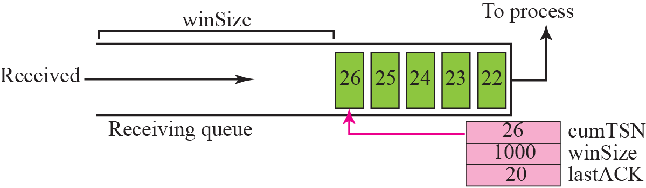
Flow control, receiver site
rwnd, cwnd: in bytes
TSN and Acknowledgement : in chunks

Slide 48
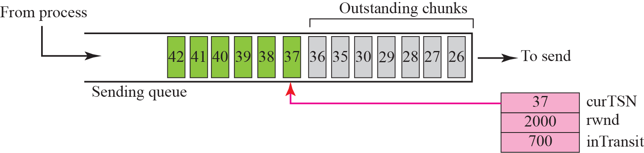
Flow control, sender site
1. A chunk pointed to by curTSN can be sent if the size of the data is less than or equal to the quantity (rwnd-inTransit)
Sent but not acknowledged
2. When a SACK is received, the chunks with a TSN less than or equal to the cumulative TSN in the SACK are removed from the queue and discarded. The values of rwnd and inTransit are updated properly

Slide 49
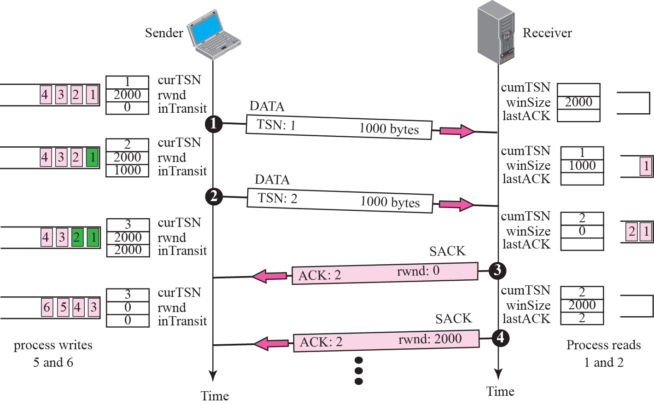
Flow control scenario

Slide 50
ERROR CONTROL
SCTP, like TCP, is a reliable transport-layer protocol. It uses a SACK chunk to report the state of the receiver buffer to the sender. Each implementation uses a different set of entities and timers for the receiver and sender sites. We use a very simple design to convey the concept to the reader.

Slide 51
Topics Discussed in the Section
Receiver Site
Sender Site
Sending Data Chunks
Generating SANK Chunks

Slide 52
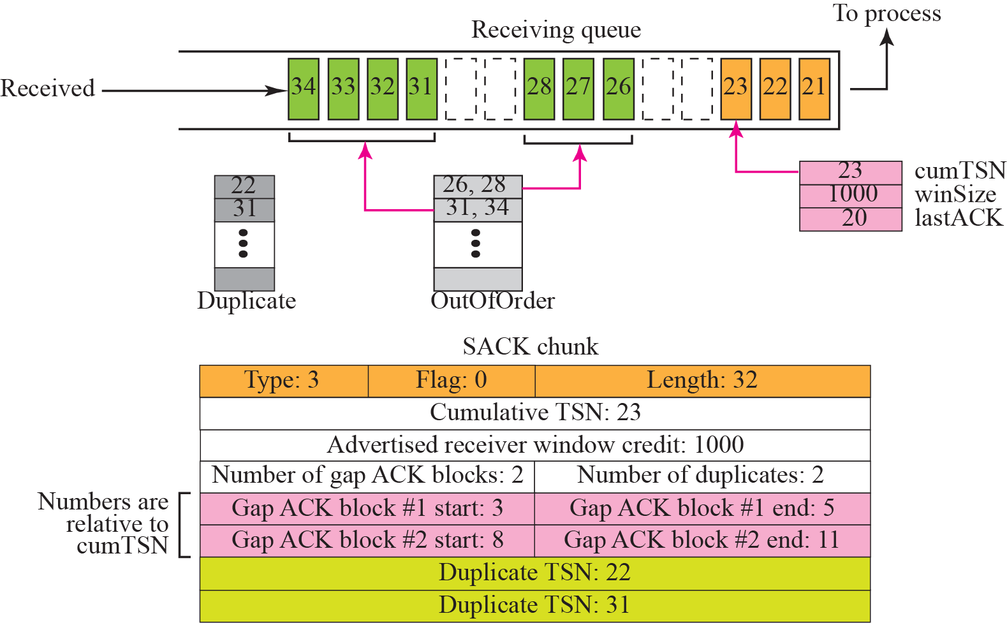
Error-control receiver site
11
10
9
8
7
6
5
4
3
2
1

Slide 53
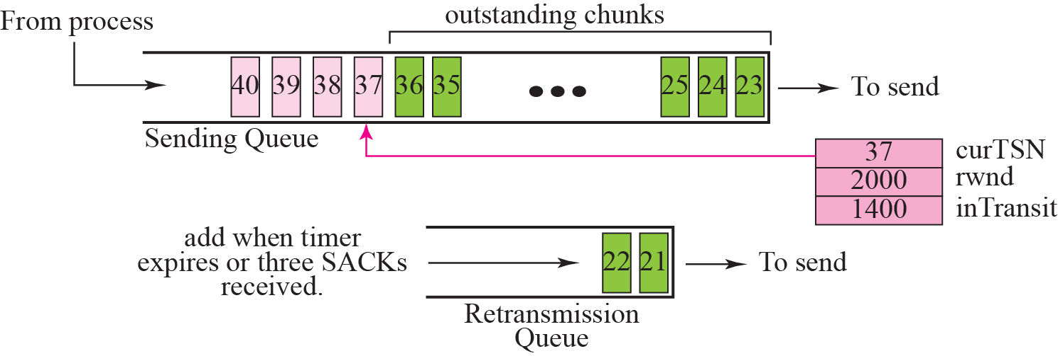
Error control, sender site
Assume 100 bytes per chunk
Timeout
4 SACKs
The chunks in the retransmission queue have priority

Slide 54
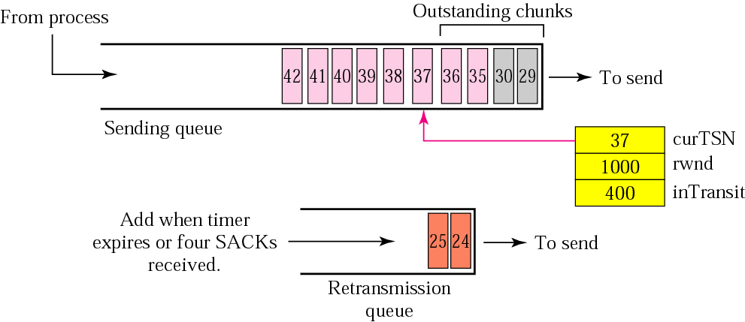
New state at the sender site after receiving a SACK chunk
Chunks 26-28, 31-34 are removed.
The value of rwnd is changed to 1000 as advertised in the SACK chunk.
Not include 24, 25
Also assume timer for chunks 24, 25 has expired. New TO is set according to exponential backoff rule in Chapter 12.
4 chunks are now in transit, so inTransit becomes 400.

Slide 55
CONGESTION CONTROL
SCTP, like TCP, is a transport layer protocol with packets subject to congestion in the network. The SCTP designers have used the same strategies we described for congestion control in Chapter 15 for TCP. SCTP has slow start, congestion avoidance, and congestion detection phases. Like TCP, SCTP also uses fast retransmission and fast recovery.

Slide 56
Topics Discussed in the Section
Congestion Control and Multihoming
Explicit Congestion Notification
Need to have different values of cwnd for each IP address
It is a process that enables a receiver to explicitly inform the sender of any congestion experienced in the network.
E.g. the receiver encounters many delayed or lost packets.

