Slide 1




LENDI INSTITUTE OF ENGINEERING AND TECHNOLOGY
(Autonomous)
Approved by AICTE and Permanently affiliated to JNTU Gurajada-Vizianagaram.
ECE,EEE,CSE&MECH
DEPARTMENT OF
COMPUTER SCIENCE AND ENGINEERING
NAME OF THE SUBJECT : DBMS
NAME OF THE TOPIC : UNIT – 4 Transaction Management
PRESENTED BY :
Dr. M. Satyanarayana
Professor, Dept. of CSE, LIET

Slide 2

UNIT 4
Transaction management
by
Dr. Satyanarayana.mummana

Slide 3
Topics to discuss
Transaction, Transaction States
The ACID Properties, Concurrent Executions, Schedules
Serializability And Types,
Concurrent Control, Concurrency Control Protocols,
Snapshot isolation– Multiple Granularity locking, Deadlocks,
Crash Recovery: Introduction To ARIES,
The Log,
Write-Ahead Log Protocol,
Recovering From A System Crash

Slide 4
What is a Transaction?
A transaction is an event that occurs on the database. Generally, a transaction reads a value from the database or writes a value to the database.
If you have any concept of Operating Systems, then we can say that a transaction is analogous to processes.

Slide 5
A transaction is a logical unit of work with database access operations ( read and write ).
Collections of operations that form a single logical unit of work are called transactions. or A transaction is an atomic unit of work that should either be completed in its entirety or not done at all. A transaction is a unit of program execution that accesses and possibly updates various data items. The transaction consists of all operations executed between the beginning transaction and the end transaction after a transaction is committed, and the database researches to a new consistent state. It may be rolled back or undone.

Slide 6
Different operations of a Transaction or the recovery manager of the DBMS needs to keep track of the following operations:
BEGIN_TRANSACTION. This marks the beginning of transaction execution.
READ or WRITE. These specify read or write operations on the database items that are executed as part of a transaction.
END_TRANSACTION. This specifies that READ and WRITE transaction operations have ended and marks the end of transaction execution. at this point, it may be necessary to check whether the changes introduced by the transaction can be permanently applied to the database (committed) or whether the transaction has to be aborted because it violates serializability or for some other reason.
COMMIT_TRANSACTION. This signals a successful end of the transaction so that any changes (updates) executed by the transaction can be safely committed to the database and will not be undone.
ROLLBACK (or ABORT). This signals that the transaction has ended unsuccessfully so that any changes or effects that the transaction may have applied to the database must be undone.

Slide 7
Example: Transfer of 50₹ from Account A to Account B. Initially A= 500₹, B= 800₹. This data is brought to RAM from Hard Disk.
BEGIN_TRANSACTION
R(A) -- 500 // Accessed from RAM.
A = A-50 // Deducting 50₹ from A.
W(A)--450 // Updated in RAM.
R(B) -- 800 // Accessed from RAM.
B=B+50 // 50₹ is added to B's Account.
W(B) --850 // Updated in RAM.
commit // The data in RAM is taken back to Hard Disk.
END_TRANSACTION

Slide 8
Uses of Transaction Management:
The DBMS is used to schedule the access of data concurrently. It means that the user can access multiple data from the database without being interfered with by each other. Transactions are used to manage concurrency. It is also used to satisfy ACID properties. It is used to solve Read/Write Conflicts. It is used to implement Recoverability, Serializability, and Cascading. Transaction Management is also used for Concurrency Control Protocols and the Locking of data.
Problems in database Transactions:
1. Inconsistency of results
2. Interference from other transactions.
3. Ambiguity in deciding when to make changes permanent.
To avoid these problems transaction has properties called ACID properties

Slide 9
The Four Properties of Transactions
Every transaction, for whatever purpose it is being used, has the following four properties. Taking the initial letters of these four properties we collectively call them the ACID Properties. Here we try to describe them and explain them.
Atomicity
Consistency
Isolation
Durability

Slide 10
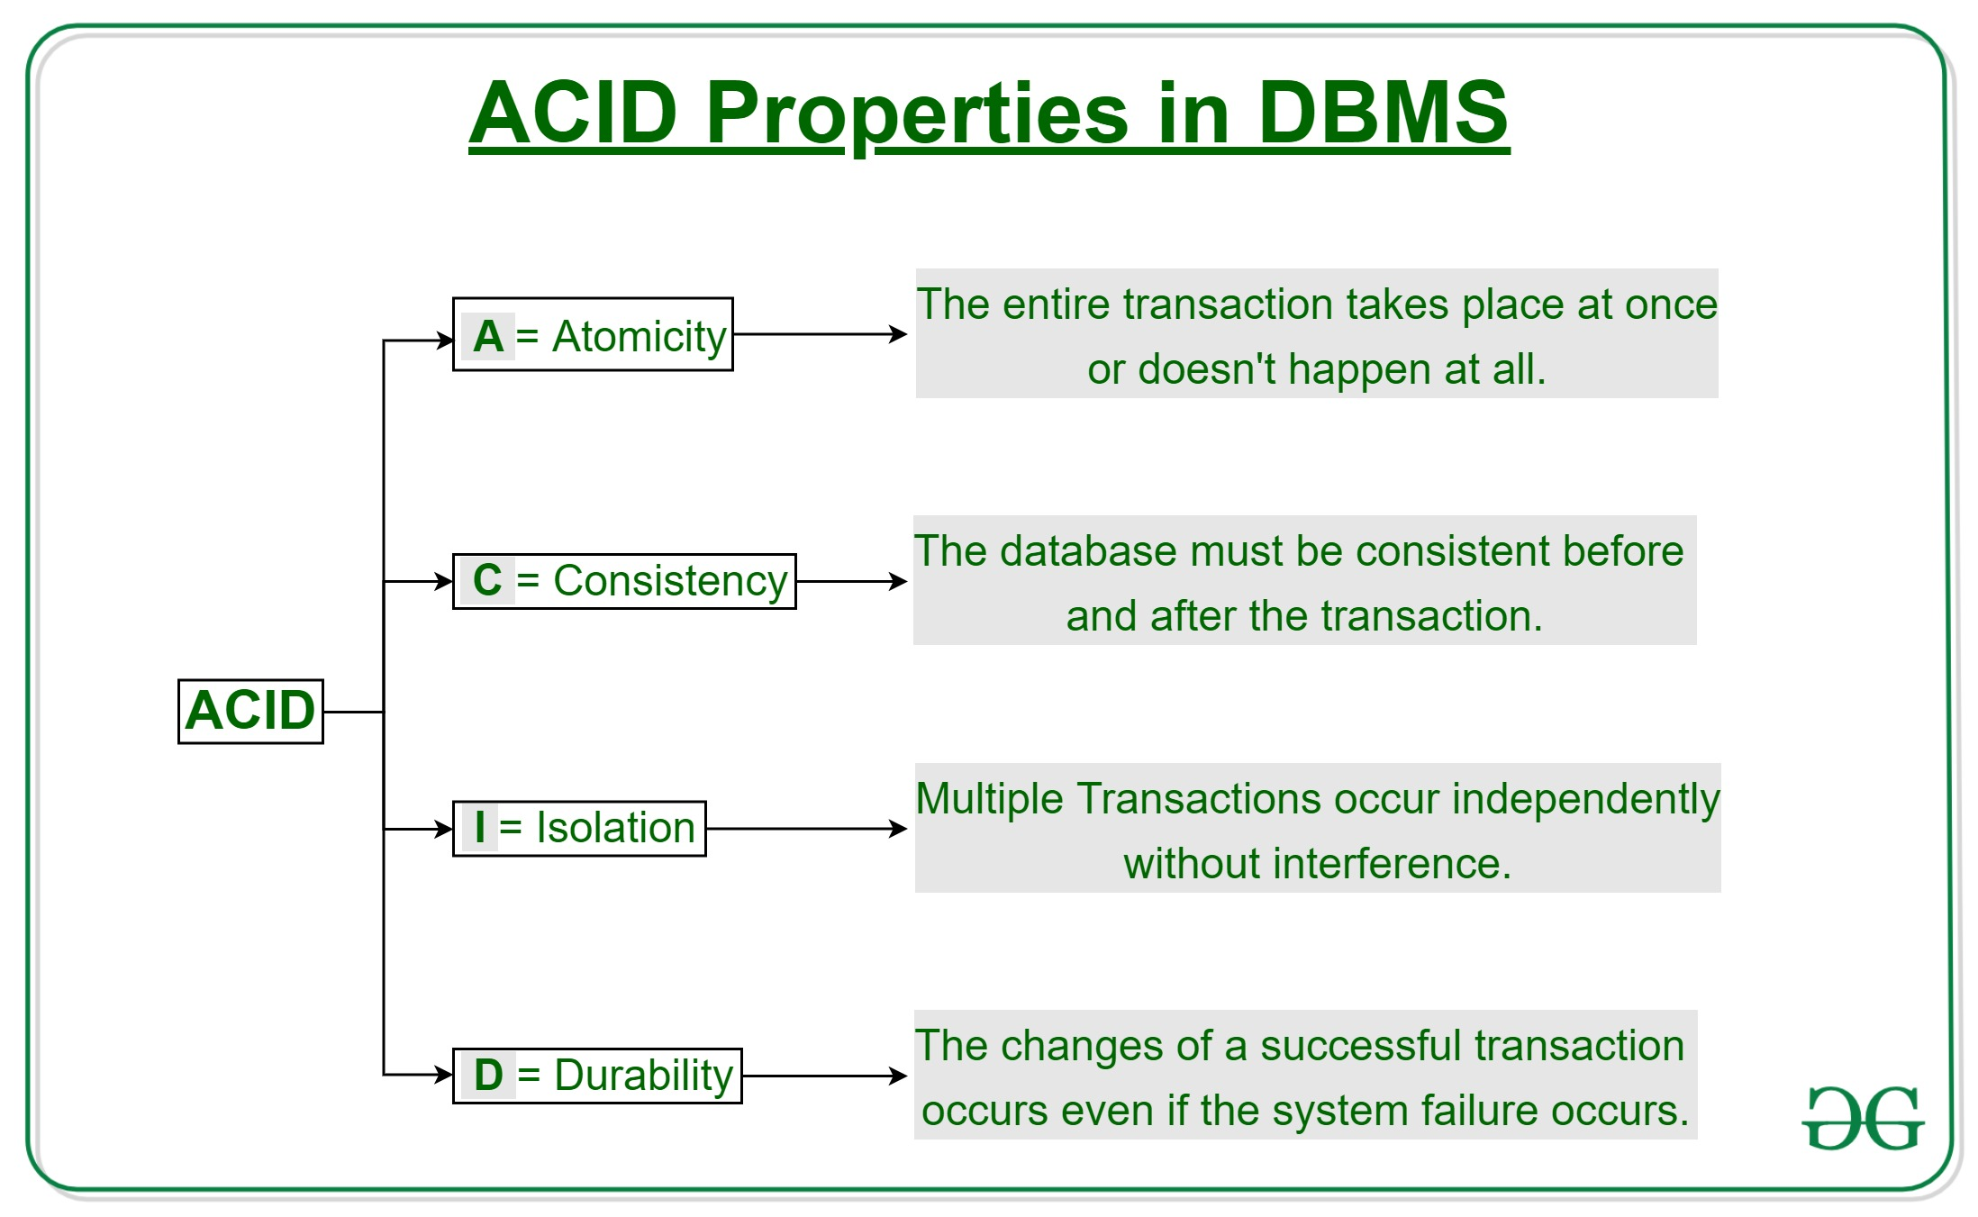

Slide 11
1) Atomicity
The term atomicity defines that the data remains atomic. It means if any operation is performed on the data, either it should be performed or executed completely or should not be executed at all. It further means that the operation should not break in between or execute partially. In the case of executing operations on the transaction, the operation should be completely executed and not partially.
2) Consistency
The word consistency means that the value should remain preserved always. In DBMS, the integrity of the data should be maintained, which means if a change in the database is made, it should remain preserved always. In the case of transactions, the integrity of the data is very essential so that the database remains consistent before and after the transaction. The data should always be correct.

Slide 12
3) Isolation
The term 'isolation' means separation. In DBMS, Isolation is the property of a database where no data should affect the other one and may occur concurrently. In short, the operation on one database should begin when the operation on the first database gets complete. It means if two operations are being performed on two different databases, they may not affect the value of one another. In the case of transactions, when two or more transactions occur simultaneously, the consistency should remain maintained. Any changes that occur in any particular transaction will not be seen by other transactions until the change is not committed in the memory.
4) Durability
Durability ensures the permanency of something. In DBMS, the term durability ensures that the data after the successful execution of the operation becomes permanent in the database. The durability of the data should be so perfect that even if the system fails or leads to a crash, the database still survives. However, if gets lost, it becomes the responsibility of the recovery manager for ensuring the durability of the database. For committing the values, the COMMIT command must be used every time we make changes.

Slide 15
Atomicity:
This means that either all of the instructions within the transaction will be reflected in the database, or none of them will be reflected.
Say for example, we have two accounts A and B, each containing Rs 1000/-. We now start a transaction to deposit Rs 100/- from account A to Account B.
Read A;
A = A – 100;
Write A;
Read B;
B = B + 100;
Write B;
The solution is to keep every value calculated by the instruction of the transaction not in any stable storage (hard disc) but in volatile storage (RAM), until the transaction completes its last instruction. When we see that there has not been any error we do something known as a COMMIT operation. Its job is to write every temporarily calculated value from the volatile storage onto the stable storage. In this way, even if power fails at instruction 3, the post-recovery image of the database will show accounts A and B both containing Rs 1000/-, as if the failed transaction had never occurred.

Slide 16
Consistency: If we execute a particular transaction in isolation or together with other transaction, (i.e. presumably in a multi-programming environment), the transaction will yield the same expected result.
Isolation: In case multiple transactions are executing concurrently and trying to access a sharable resource at the same time, the system should create an ordering in their execution so that they should not create any anomaly in the value stored at the sharable resource.
Durability: It states that once a transaction has been completed the changes it has made should be permanent.

Slide 17
2. Consistency: Once the transaction is executed, it should move from one consistent state to another. A transaction should be consistency preserving, meaning that if it is completely executed from beginning to end without interference from other transactions, it should take the database from one consistent state to another. The integrity constraints are maintained so that the database is consistent before and after the transaction. The execution of a transaction will leave a database in either its prior stable state or a new stable state. The transaction is used to transform the database from one consistent state to another consistent state.

Slide 18
For example The total amount must be maintained before or after the transaction.
Total before T occurs = 1000+300=1300
Total after T occurs= 2000+400=2400
Therefore, the database is consistent. In the case when T1 is completed but T2 fails, then inconsistency will occur.
1.read(A) 2.A := A – 50 3.write(A) 4.read(B) 5.B := B + 50 6.write(B)
Consistency requirement in the above example: The sum of A and B is unchanged by the execution of the transaction In general, consistency requirements include Explicitly specified integrity constraints such as primary keys and foreign keys Implicit integrity constraints
e.g., the sum of balances of all accounts, minus the sum of loan amounts must equal the value of cash-in-hand A transaction, when starting to execute, must see a consistent database. During transaction execution, the database may be temporarily inconsistent. When the transaction completes successfully the database must be consistent. Erroneous transaction logic can lead to inconsistency.

Slide 19
Transaction States
There are the following six states in which a transaction may exist:
Active: The initial state when the transaction has just started execution.
Partially Committed: At any given point of time if the transaction is executing properly, then it is going towards it COMMIT POINT. The values generated during the execution are all stored in volatile storage.
Failed: If the transaction fails for some reason. The temporary values are no longer required, and the transaction is set to ROLLBACK. It means that any change made to the database by this transaction up to the point of the failure must be undone. If the failed transaction has withdrawn Rs. 100/- from account A, then the ROLLBACK operation should add Rs 100/- to account A.

Slide 20
Aborted: When the ROLLBACK operation is over, the database reaches the BFIM. The transaction is now said to have been aborted.
Committed: If no failure occurs then the transaction reaches the COMMIT POINT. All the temporary values are written to the stable storage and the transaction is said to have been committed.
Terminated: Either committed or aborted, the transaction finally reaches this state.

Slide 21
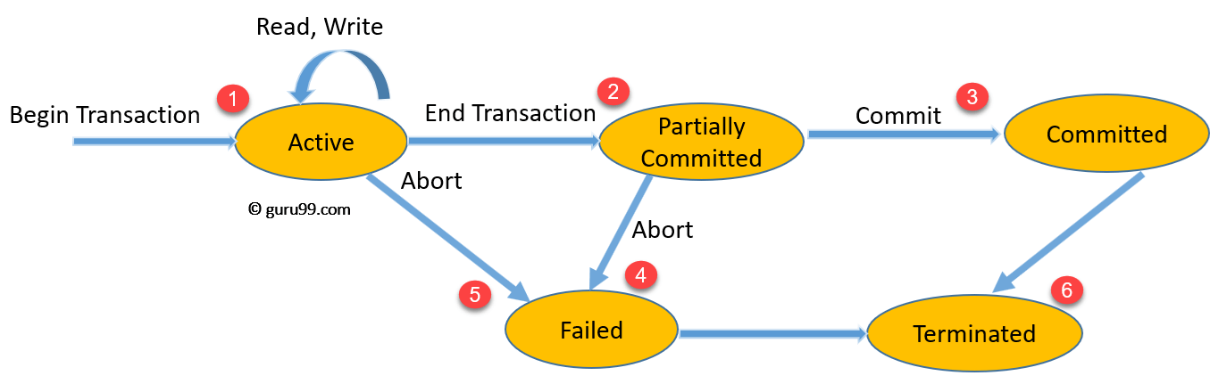
The whole process can be described using the following diagram:

Slide 22
What is a Schedule?
A Schedule is a process creating a single group of the multiple parallel transactions and executing them one by one. It should preserve the order in which the instructions appear in each transaction. If two transactions are executed at the same time, the result of one transaction may affect the output of other.
Example
Initial Product Quantity is 10
Transaction 1: Update Product Quantity to 50
Transaction 2: Read Product Quantity

Slide 23
Schedule: A series of operations from one transaction to another transaction is known as schedule. It is used to preserve the order of the operation in each of individual transaction.
Different Types of Schedules:
      1. Serial Schedule
      2. Non-serial Schedule
      i. Serializable schedule
          Conflict Serializability
          View Serializability
      ii. Non-Serializable Schedules
          Recoverable Schedules
              Cascading Schedule
              Cascadeless Schedule
              Strict Schedule
          Non-Recoverable Schedules or Irrecoverable Schedules

Slide 24
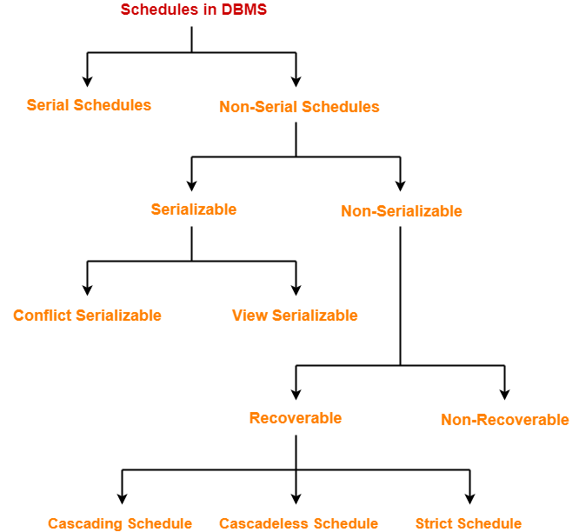

Slide 25
1. Serial Schedule: The serial schedule is a type of schedule where one transaction is executed completely before starting another transaction. All the transactions execute serially one after the other. When one transaction executes, no other transaction is allowed to execute.
For example: Suppose there are two transactions T1 and T2 which have some operations. If it has no interleaving of operations, then there are the following two possible outcomes: Execute all the operations of T1 which was followed by all the operations of T2. Execute all the operations of T2 which was followed by all the operations of T1.

Slide 26
2. Non-serial Schedule
This is a type of Scheduling where the operations of multiple transactions are interleaved. If the interleaving of operations is allowed, then there will be a non-serial schedule. It contains many possible orders in which the system can execute the individual operations of the transactions. This might lead to a rise in the concurrency problem. The transactions are executed in a non-serial manner, keeping the end result correct and the same as the serial schedule. In non-serial schedules, Multiple transactions execute concurrently. Operations of all the transactions are interleaved or mixed with each other.
Characteristics: Non-serial schedules are NOT always, Consistent, Recoverable ,Cascadeless, Strict

Slide 27
Serializable: If a given non-serial schedule of ‘n’ transactions is equivalent to some serial schedule of ‘n’ transactions, it is called a serializable schedule. It is mainly used in Non-Serial scheduling to verify whether the scheduling will lead to any inconsistency or not. A nonserial schedule will be serializable if its result is equal to the result of its transactions executed serially. A serializable schedule helps in improving both resource utilization and CPU throughput.

Slide 28
Serial Schedules Vs Serializable Schedules
Serial Schedules | Serializable Schedules
No concurrency is allowed. Thus, all the transactions necessarily execute serially one after the other. | Concurrency is allowed. Thus, multiple transactions can execute concurrently.
Serial schedules lead to less Resource utilization and CPU throughput. | Serializable schedules improve both resource utilization and CPU throughput.
Serial Schedules are less efficient as compared to serializable schedules.(due to above reason) | Serializable Schedules are always better than serial schedules. (due to above reason)

Slide 29
Types of Serializability: Serializability is mainly of two types
1. Conflict Serializability
2. View Serializability
Conflict Serializability: If a given non-serial schedule can be converted into a serial schedule by swapping its non-conflicting operations, it is called a conflict serializable schedule.
Conflicting Operations: Two operations are called as conflicting operations if all the following conditions hold true for them
Both operations belong to different transactions,
Both operations are on the same data item
At least one of the two operations is a write operation

Slide 30
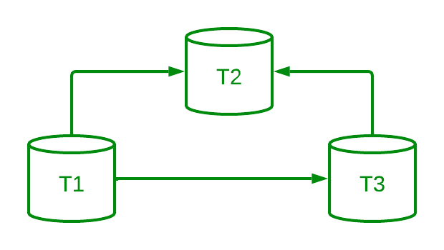

Slide 31
View Serializability:
View Equivalent Schedules: Consider two schedules S1 and S2 each consisting of two transactions T1 and T2. Schedules S1 and S2 are called view equivalent if the following three conditions hold true for them.
Condition-01: For each data item X, if transaction Ti reads X from the database initially in schedule S1, then in schedule S2 also, Ti must perform the initial read of X from the database.
Thumb Rule: ”Initial readers must be same for all the data items”.
Condition-02:If transaction Ti reads a data item that has been updated by the transaction Tj in schedule S1, then in schedule S2 also, transaction Ti must read the same data item that has been updated by the transaction Tj.
Thumb Rule : “Write-read sequence must be same.”.

Slide 32
Condition-03:For each data item X, if X has been updated at last by transaction Ti in schedule S1, then in schedule S2 also, X must be updated at last by transaction Ti.
Thumb Rule: “Final writers must be same for all the data items”.

Slide 33
Non-Serializable Schedules: A non-serializable schedule is not guaranteed to produce the same effect as some serial schedule on any consistent database.
The non-serializable schedule is divided into two types,
1. Recoverable Schedule
2. Non-recoverable Schedule Or Irrecoverable Schedules
Recoverable Schedules: A transaction performs a dirty read operation from an uncommitted transaction And its commit operation is delayed till the uncommitted transaction either commits or rollbacks then such a schedule is called as a Recoverable Schedule.
Types of Recoverable Schedules, A recoverable schedule may be any one of these kinds
    1. Cascading Schedule
    2. Cascadeless Schedule
    3. Strict Schedule

Slide 34
Cascading Schedule: If in a schedule, failure of one transaction causes several other dependent transactions to rollback or abort, then such a schedule is called as a Cascading Schedule or Cascading Rollback or Cascading Abort. It simply leads to the wastage of CPU time.
Cascade less Schedule: If in a schedule, a transaction is not allowed to read a data item until the last transaction that has written it is committed or aborted such a schedule is called as a Cascade less Schedule.
Strict Schedule: If in a schedule, a transaction is neither allowed to read nor write a data item until the last transaction that has written it is committed or aborted, then such a schedule is called a Strict Schedule.

Slide 35
2. Irrecoverable Schedules: If in a schedule, A transaction performs a dirty read operation from an uncommitted transaction And commits before the transaction from which it has read the value
then such a schedule is known as an Irrecoverable Schedule.
Some Anomalies Associated with Interleaved Execution:
Different types of problems encounter when two simple transactions if they run concurrently.
Dirty Read Problem
Unrepeatable Reads (RW Conflicts) or Unrepeatable Read Problem
The Lost Update Problem(WW Conflicts)
Phantom Read Problem

Slide 36
1. Dirty Read Problem: Reading the data written by an uncommitted transaction is called as dirty read. Reading Uncommitted Data (WR Conflicts) or The Temporary Update (or Dirty Read) Problem. The first source of anomalies is that a transaction T2 could read a database object A that has been modified by another transaction T1, which has not yet committed. Such a read is called a dirty read. This read is called as dirty read because: There is always a chance that the uncommitted transaction might roll back later. Thus, uncommitted transaction might make other transactions read a value that does not even exist. This leads to inconsistency of the database.
        Example
        T1 T2
        -----------------------------
        R(A)
        W(A)
        . R(A) // Dirty Read
        . W(A)
        . commit;
        failure

Slide 37
2. Unrepeatable Reads (RW Conflicts) or Unrepeatable Read Problem
The unrepeatable problem occurs when two or more read operations of the same transaction read different values of the same variable. This problem occurs when a transaction gets to read unrepeated i.e. different values of the same variable in its different read operations even when it has not updated its value.
T1 T2
-----------------------------
R(X)
R(X)
W(X)
R(X);//unrepeated

Slide 38
3. The Lost Update Problem(WW Conflicts) ( blind write) OR Overwriting Uncommitted Data (WW Conflicts):
In the lost update problem, an update done to a data item by a transaction is lost as it is overwritten by the update done by another transaction.This problem occurs when multiple transactions execute concurrently and updates from one or more transactions get lost.
Example
T1 T2
-----------------------------
R(A)
W(A)
. W(A)
. commit
commit

Slide 39
4. Phantom Read Problem
This problem occurs when a transaction reads some variable from the buffer and when it reads the same variable later, it finds that the variable does not exist.
Example:
T1 T2
-----------------------------
R(A)
W(A)
delete(A)
R(A)
Here,T1 reads A.T2 reads A.T1 deletes A.T2 tries reading A but does not find it.In this example,T2 finds that there does not exist any variable X when it tries reading X again.T2 wonders who deleted the variable X because according to it, it is running in isolation.

Slide 40
Concurrent Execution
A schedule is a collection of many transactions which is implemented as a unit. Depending upon how these transactions are arranged in within a schedule, a schedule can be of two types:
Serial: The transactions are executed one after another, in a non-preemptive manner.
Concurrent: The transactions are executed in a preemptive, time shared method. In Serial schedule, there is no question of sharing a single data item among many transactions, because not more than a single transaction is executing at any point of time. However, a serial schedule is inefficient in the sense that the transactions suffer for having a longer waiting time and response time, as well as low amount of resource utilization.

Slide 41
In concurrent schedule, CPU time is shared among two or more transactions in order to run them concurrently. However, this creates the possibility that more than one transaction may need to access a single data item for read/write purpose and the database could contain inconsistent value if such
accesses are not handled properly. Let us explain with the help of an example.

Slide 42
Question 1: Consider the following transaction involving two bank accounts x and y:
read(x);
x := x – 50;
write(x);
read(y);
y := y + 50;
write(y);
The constraint that the sum of the accounts x and y should remain constant is that of?
Atomicity
Consistency
Isolation
Durability

Slide 43
Concurrent Executions: Multiple transactions are allowed to run concurrently in the system.
Advantages: The advantages of concurrency control are as follows −
1. Waiting time will be decreased.
2. Response time will decrease.
3. Resource utilization will increase.
4. System performance & Efficiency is increased.
Increased processor and disk utilization, leading to better transaction throughput CPU activity and I/O activity. The CPU and the disk in a computer system can operate in parallel. E.g. one transaction can be using the CPU while another is reading from or writing to the disk

Slide 44
Concurrency Control Protocols
Two-Phase Locking (2PL)
A. Strict 2PL
B. Rigorous 2PL
2. Timestamp-Based Protocols
3. Multi-Version Concurrency Control (MVCC)
4. Validation-Based Protocols
5. Graph-Based Protocols
6. Hybrid Protocols
7. Snapshot Isolation
8. Multiple Granularity Locking (MGL)
1. Intention Locks:
2. Actual Locks:

Slide 45
Lock Based Concurrency Control Protocol or Lock-Based Protocols:
A DBMS must be able to ensure that only serializable, recoverable schedules are allowed and that no actions of committed transactions are lost while undoing aborted transactions. A DBMS typically uses a locking protocol to achieve this. A locking protocol is a set of rules to be followed by each transaction in order to ensure that even though actions of several transactions might be interleaved, the net effect is identical to executing all transactions in some serial order.
Locks :
A lock is a variable associated with a data item that describes the status of the item with respect to possible operations that can be applied to it. There is one lock for each data item in the database. Locks are used as a means of synchronizing the access by concurrent transactions to the database items. A Lock is a mechanism to control the access on the particular Data Item. There are various modes in which a data item may be locked several types of locks are used in concurrency control
Binary Locks
Shared/Exclusive (or Read/Write) Locks

Slide 46
Binary Locks:
A binary lock can have two states or values. locked and unlocked (or 1 and 0, for simplicity). Two operations, lock_item and unlock_item, are used with binary locking.A transaction requests access to an item X by first issuing a lock_item(X) operation. If LOCK(X) = 1, the transaction is forced to wait. If LOCK(X) = 0, it is set to 1 (the transaction locks the item) and the transaction is allowed to access item X. When the transaction is through using the item, it issues an unlock_item(X) operation, which sets LOCK(X) back to 0 (unlocks the item) so that X may be accessed by other transactions.

Slide 47
2.Shared/Exclusive (or Read/Write) Locks
Shared: If a transaction Ti has obtained a shared-mode lock (denoted by S) on item Q, then Ti can read, but cannot write, Q. It is also known as a Read-only lock. In a shared lock, the data item can only read by the transaction.It can be shared between the transactions because when the transaction holds a lock, then it can't update the data on the data item.
Exclusive: If a transaction Ti has obtained an exclusive-mode lock (denoted by X) on item Q, then Ti can both read and write Q.In the exclusive lock, the data item can be both reads as well as written by the transaction.This lock is exclusive, and in this lock, multiple transactions do not modify the same data simultaneously.

Slide 48
The Two-Phase Locking Protocol :
One protocol that ensures conflict-serializability is the two-phase locking protocol.in 2PL protocol requires that each transaction issue lock and unlock requests in two phases.
A transaction is said to follow the Two-Phase Locking protocol if Locking and Unlocking can be done in two phases. There are two phases of 2PL:
Growing phase: or expanding: In the growing phase A transaction may obtain locks but may not release any locks. In the growing phase, a new lock on the data item may be acquired by the transaction, but none can be released. New locks on data items may be acquired but none can be released.

Slide 49
Shrinking phase:
A transaction may release locks but may not obtain any new locks. In the shrinking phase, existing lock held by the transaction may be released, but no new locks can be acquired. The two-phase locking protocol divides the execution phase of the transaction into three parts. In the first part, when the execution of the transaction starts, it seeks permission for the lock it requires. In the second part, the transaction acquires all the locks. The third phase is started as soon as the transaction releases its first lock. In the third phase, the transaction cannot demand any new locks. It only releases the acquired locks. In the below example, if lock conversion is allowed then the following phase can happen:
Upgrading of lock (from S(a) to X (a)) is allowed in growing phase.Downgrading of lock (from X(a) to S(a)) must be done in shrinking phase.

Slide 50
Timestamp Concurrency Control Algorithms
Timestamp-based concurrency control algorithms use a transaction’s timestamp to coordinate concurrent access to a data item to ensure serializability. A timestamp is a unique identifier given by DBMS to a transaction that represents the transaction’s start time.
These algorithms ensure that transactions commit in the order dictated by their timestamps. An older transaction should commit before a younger transaction, since the older transaction enters the system before the younger one.
Timestamp-based concurrency control techniques generate serializable schedules such that the equivalent serial schedule is arranged in order of the age of the participating transactions.

Slide 51
Some of timestamp based concurrency control algorithms are −
• Basic timestamp ordering algorithm.
• Conservative timestamp ordering algorithm.
• Multiversion algorithm based upon timestamp ordering.
Timestamp-based ordering follows three rules to enforce serializability −
• Access Rule − When two transactions try to access the same data item simultaneously, for conflicting operations, priority is given to the older transaction. This causes the younger transaction to wait for the older transaction to commit first.
• Late Transaction Rule − If a younger transaction has written a data item, then an older transaction is not allowed to read or write that data item. This rule prevents the older transaction from being committed after the younger transaction has already been committed.
• Younger Transaction Rule − A younger transaction can read or write a data item that has already been written by an older transaction.

Slide 52
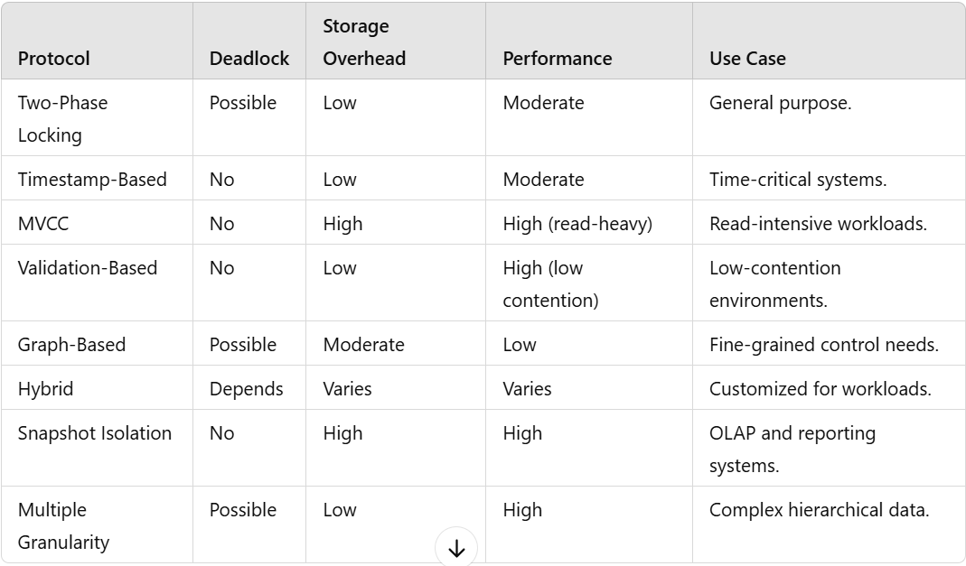

Slide 53
1. Two-Phase Locking Protocol (2PL)
Concept: Transactions are divided into two phases:
  Growing Phase: Locks are acquired but not released.
  Shrinking Phase: Locks are released, but no new locks are acquired.
Variants:
  Strict 2PL: All locks are held until the transaction commits or aborts.
  Rigorous 2PL: All locks are released only after the transaction commits.
Advantages:
  Guarantees serializability.
  Strict 2PL prevents cascading rollbacks.
Disadvantages:
  Deadlocks may occur.
  Can lead to reduced concurrency.

Slide 54
2. Timestamp-Based Protocols
Concept: Each transaction is assigned a unique timestamp. Operations are executed based on these timestamps to ensure serializability.
Rules:
  A read operation is allowed if the transaction's timestamp is greater than the write timestamp of the data item.
  A write operation is allowed if the transaction's timestamp is greater than the read and write timestamps of the data item.
Advantages:
  No deadlocks.
  Simple conflict resolution.
Disadvantages:
  May lead to unnecessary transaction aborts.
  High overhead for maintaining timestamps.

Slide 55
3. Multi-Version Concurrency Control (MVCC)
Concept: Maintains multiple versions of data items to enable concurrent access without locking.
Working:
  Each data item has a read timestamp and a write timestamp.
  Transactions read the latest version valid for their timestamp and write new versions for changes.
Advantages:
  No locking needed for reads.
  High performance for read-heavy workloads.
Disadvantages:
  Increased storage requirement.
  Complexity in version management.

Slide 56
4. Validation-Based Protocols
Concept: Transactions execute in three phases:
  Read Phase: Operations are performed locally without affecting the database.
  Validation Phase: Conflicts with other transactions are checked.
  Write Phase: Updates are applied to the database if validation succeeds.
Advantages:
  No locking needed.
  Effective in environments with low contention.
Disadvantages:
  High abort rate under high contention.
  Validation overhead.

Slide 57
5. Graph-Based Protocols
Concept: Transactions are represented as nodes in a graph, with edges representing dependencies. Cycles in the graph indicate conflicts.
Working:
  Transactions execute only if the precedence graph remains acyclic.
Advantages:
  Provides fine-grained control.
Disadvantages:
  High overhead for maintaining the graph.

Slide 58
6. Hybrid Protocols
Concept: Combines features of multiple protocols (e.g., Two-Phase Locking with Timestamp Ordering) to balance performance and correctness.
Advantages:
  Tailored for specific workloads.
Disadvantages:
  Complexity in implementation.

Slide 59
7. Snapshot Isolation
Concept: Provides each transaction with a "snapshot" of the database state as of the transaction's start time.
Rules:
  Transactions read consistent data as of their snapshot.
  Writes conflict if two transactions update the same data concurrently.
Advantages:
  No locking for reads.
  High performance in read-heavy scenarios.
Disadvantages:
  Allows some anomalies like write skew.
  Increased storage requirements.

Slide 60
8. Multiple Granularity Locking (MGL)
Concept: Allows transactions to lock data items at different levels of granularity, such as row, table, or database.
Locks:
  Intention Locks:
    Intention Shared (IS): Indicates intention to read.
    Intention Exclusive (IX): Indicates intention to write.
  Actual Locks:
    Shared (S): Allows read access.
    Exclusive (X): Allows write access.
Advantages:
  Reduces locking overhead for large datasets.
Disadvantages:
  Complexity in lock management.

Slide 61
8.Crash Recovery:
Different Types of Failures: Failures are generally classified as transaction, system, and media failures. There are several possible reasons for a transaction to fail in the middle of execution:
1. A computer failure (system crash):
A hardware, software, or network error occurs in the computer system during transaction execution. Hardware crashes are usually media failures—for example, main memory failure.
2. A transaction or system error: Some operation in the transaction may cause it to fail, such as integer overflow or division by zero. Transaction failure may also occur because of erroneous parameter values or because of a logical programming error. Additionally, the user may interrupt the transaction during its execution.

Slide 62
3. Local errors or exception conditions detected by the transaction: During transaction execution, certain conditions may occur that necessitate cancellation of the transaction.
For example, data for the transaction may not be found. An exception condition, such as insufficient account balance in a banking database, may cause a transaction, such as a fund withdrawal, to be cancelled. This exception could be programmed in the transaction itself, and in such a case would not be considered as a transaction failure.
4. Concurrency control enforcement: The concurrency control method may decide to abort a transaction because it violates serializability or it may abort one or more transactions to resolve a state of deadlock among several transactions .Transactions aborted because of serializability violations or deadlocks are typically restarted automatically at a later time.

Slide 63
5. Disk failure: Some disk blocks may lose their data because of a read or write malfunction or because of a disk read/write head crash. This may happen during a read or a write operation of the transaction.
6. Physical problems and catastrophes: This refers to an endless list of problems that includes power or air-conditioning failure, fire, theft, sabotage, overwriting disks or tapes by mistake, and mounting of a wrong tape by the operator
Failures of types 1, 2, 3, and 4 are more common than those of types 5 or 6.Whenever a failure of type 1 through 4 occurs, the system must keep sufficient information to quickly recover from the failure. Disk failure or other catastrophic failures of type 5 or 6 do not happen frequently; if they do occur, recovery is a major task.

Slide 64
CRASH RECOVERY
The recovery manager of a DBMS is responsible for ensuring two important properties of transactions: atomicity and durability. It ensures atomicity by undoing the actions of transactions that do not commit and durability by making sure that all actions of committed transactions survive system crashes, and media failures (e.g., a disk is corrupted). The recovery manager is one of the hardest components of a DBMS to design and implement.
steal: if a frame is dirty and chosen for replacement, the page it contains is written to disk even if the modifying transaction is still active.
Noforce: pages in the buffer pool that are modified by the transaction are not forced to disk when the transaction commits.

Slide 65
INTRODUCTION TO ARIES
ARIES is a recovery algorithm that is designed to work with a steal, no-force approach. When the recovery manager is invoked after a crash, restart proceeds in three phases:
1. Analysis: Identifies dirty pages in the buffer pool (i.e., changes that have not been written to disk) and active transactions at the time of the crash.
2. Redo: Repeats all actions, starting from an appropriate point in the log, and restores the database state to what it was at the time of the crash.
3. Undo: Undoes the actions of transactions that did not commit, so that the database reflects only the actions of committed transactions.

Slide 66
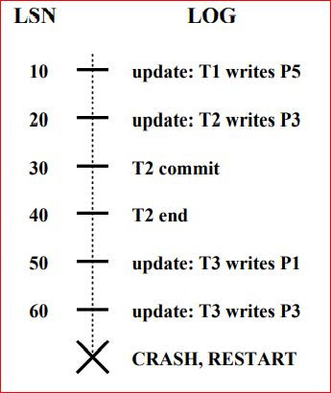
log sequence number (LSN)

Slide 67
There are three main principles behind the ARIES recovery algorithm:
Write-ahead logging: Any change to a database object is first recorded in the log; the record in the log must be written to stable storage before the change to the database object is written to disk.
Repeating history during Redo: Upon restart following a crash, ARIES retraces all actions of the DBMS before the crash and brings the system back to the exact state that it was in at the time of the crash. Then, it undoes the actions of transactions that were still active at the time of the crash (effectively aborting them)
Logging changes during Undo: Changes made to the database while undoing a transaction are logged in order to ensure that such an action is not repeated in the event of repeated (failures causing) restarts.

Slide 68
The Log: The log, sometimes called the trail or journal, is a history of actions executed by the DBMS. Physically, the log is a file of records stored in stable storage, which is assumed to survive crashes; the most recent portion of the log, called the log tail, is kept in main memory and is periodically forced to stable storage. Every log record is given a unique id called the log sequence number (LSN) any record id, fetch a log record with one disk access given the LSN.LSNs should be assigned in monotonically increasing order; the LSN can simply be the address of the first byte of the log record. For recovery purposes, every page in the database contains the LSN of the most recent log record that describes a change to this page. This LSN is called the pageLSN.

Slide 69
A log record is written for each of the following actions:
Updating a page
Commit:
Abort:
End:
Undoing an update:
Updating a page: After modifying the page, an update type record is appended to the log tail. The page LSN of the page is then set to the LSN of the update log record.
Commit: When a transaction decides to commit, it force-writes a commit type log record containing the transaction id the log record is appended to the log, and the log tail is written to stable storage, up to and including the commit record
The transaction is considered to have committed at the instant that its commit log record is written to stable storage.
Abort: When a transaction is aborted, an abort type log record containing the transaction id is appended to the log, and Undo is initiated for this transaction

Slide 70
End: when a transaction is aborted or committed, some additional actions must be taken beyond writing the abort or commit log record.After all these additional steps are completed, an end type log record containing the transaction id is appended to the log.
Undoing an update: When a transaction is rolled back (because the transaction is aborted, or during recovery from a crash), its updates are undone. When the action described by an update log record is undone, a compensation log record, or CLR, is written.
types of Log Records:
Update Log Records
Compensation Log Records

Slide 71
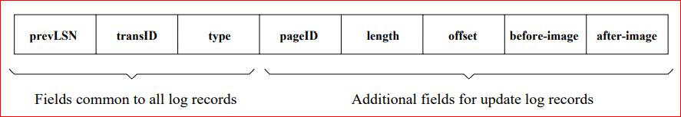

Slide 74
Overview of Crash Recovery
Definition: Crash recovery ensures that a database can recover from system crashes or failures without losing data.
Goal: Ensure database consistency after a failure.
Key Concepts:
  Transactions: Groups of operations that should be atomic.
  Logging: Keeping track of changes to the database for recovery.

Slide 75
The Log in Database Systems
Definition: A sequential record of changes made to the database.
Purpose:
  Support crash recovery.
  Maintain the order of database operations.
Structure:
  Log entries contain the before and after images of changes.
  Logs are written sequentially to a persistent storage medium.

Slide 76
Write-Ahead Log (WAL) Protocol
Definition: A protocol ensuring that log records are written to disk before the database is updated.
Principle: Ensure durability and atomicity.
  Key Rule: Before any changes are made to the database, the corresponding log record must be written.
Advantages:
  Provides atomicity: All changes are either fully written or not at all.
  Simplifies crash recovery.

Slide 77
ARIES (Algorithm for Recovery and Isolation Exploiting Semantics)
Overview: ARIES is a sophisticated crash recovery protocol used in many database systems (e.g., PostgreSQL).
Components:
  Log-based Recovery: Using logs to track changes and recover.
  Write-Ahead Logging: Ensures changes are logged before applying them to the database.
  Steal and No-Force Policies: Focuses on balancing recovery and performance.

Slide 78
Key Concepts of ARIES
Redo and Undo Operations:
  Redo: Reapply changes from the log in case of a crash.
  Undo: Rollback partial transactions to maintain consistency.
Three Phases of Recovery:
  Analysis Phase: Identify the state of the database and transactions at the time of the crash.
  Redo Phase: Reapply the changes from the log.
  Undo Phase: Undo incomplete transactions to ensure atomicity.

Slide 79
ARIES Recovery Example
Scenario: A system crash occurs.
Analysis Phase:
  ARIES examines the log to find the last committed transaction before the crash.
Redo Phase:
  Reapply all the operations that were done before the crash.
Undo Phase:
  Rollback uncommitted transactions.

Slide 80
ARIES Log Structure
Log Record Format:
  Transaction ID: Identifies the transaction.
  Log Sequence Number (LSN): Ensures proper ordering of log records.
  Before Image: The value before a change.
  After Image: The value after the change.
  Operation Type: Type of operation (e.g., write, commit).
ARIES Data Structures
Transaction Table: Tracks active transactions.
Dirty Page Table: Tracks pages that have been modified but not yet written back to disk.
Log Sequence Numbers (LSNs): Ensure the correct ordering of operations for recovery.

Slide 82
Advantages of ARIES
High Performance: ARIES is optimized for large-scale database systems.
Flexibility: It supports both steal and no-force policies.
Scalability: Handles large databases and high transaction volumes efficiently.
Recovery Efficiency: Can recover from crashes with minimal downtime.

