Slide 1
Introduction to Power System Analysis
Prepared by
Mr K.Ravi sankar
Assoc.Professor
Department of EEE

Slide 2
COURSE OBJECTIVES
To develop the impedance diagram (p.u) and formation of Y_{bus}
To study the different load flow methods
To study the concept of the Z_{bus} building algorithm
To study the effects of symmetrical and unsymmetrical faults
To study the rotor angle stability of power systems

Slide 3
COURSE OUTCOMES
Apply mathematical knowledge of per-unit quantities and Y-bus matrix formation to power system components (L3)
Analyze Gauss seidel method, Newton Raphson method, Decoupled and Fast decoupled methods to solve power problems in Power Systems (L4)
Apply Zbus formulation for symmetrical fault analysis in power systems (L3)
Analyze the power system under different unsymmetrical fault conditions (L4)
Interpret stability concepts and various methods to enhance the stability of a power system (L2)

Slide 4
SYLLABUS
UNIT –I
Per Unit Representation & Topology
Per Unit Quantities–Single line diagram– Impedance diagram of a power system–Graph theory definition – Formation of element node incidence and bus incidence matrices – Primitive network representation – Formation of Y–bus matrix by singular transformation and direct inspection methods.
UNIT – II
Power flow studies
Necessity of power flow studies – Derivation of static power flow equations – Power flow Solution using Gauss-Seidel Method – Newton Raphson Method (Rectangular and polar Coordinates form) –Decoupled and Fast Decoupled methods – Algorithmic approach – Problems on 3–bus system only.
UNIT – III
Z–Bus formulation & Symmetrical Fault analysis
Formation of Z–Bus: Partial network– Algorithm for the Modification of Z bus Matrix for the addition of branch and addition of link (Derivations and Numerical Problems)–Modification of Z–Bus for the changes in network (Problems).
Transients on a Transmission line-short circuit of synchronous machine (on no-load) - 3– Phase short circuit currents and reactance’s of synchronous machine–Short circuit MVA Calculations -Series reactors – selection of reactors.

Slide 5
UNIT – IV
Un Symmetrical Fault analysis
Definition of symmetrical components - symmetrical components of unbalanced three phase Systems – Power in symmetrical components – Sequence impedances – Synchronous Generator – Transmission line and transformers – Sequence networks –Various types of faults LG– LL– LLG and LLL on unloaded alternator–unsymmetrical faults on power system.
UNIT –V
Power System Stability Analysis
Elementary concepts of Steady state, Dynamic and Transient Stabilities– Description of Steady State Stability Power Limit–Transfer Reactance–Synchronizing Power Coefficient – Power Angle Curve and Determination of Steady State Stability –Derivation of Swing Equation–Determination of Transient Stability by Equal Area Criterion–Applications of Equal Area Criterion–Methods to improve steady state and transient stability.

Slide 6
TEXTBOOKS:
Power System Analysis by Grainger and Stevenson, Tata McGraw Hill.
Modern Power system Analysis – by I.J.Nagrath&D.P.Kothari: TataMcGraw– Hill Publishing Company, 2nd edition.
REFERENCE BOOKS:
Power System Analysis – by A.R.Bergen, Prentice Hall, Inc.
Power System Analysis by HadiSaadat – TMH Edition.
Power System Analysis by B.R.Gupta, Wheeler Publications.
Power System Analysis and Design by J.Duncan Glover, M.S.Sarma, T.J.Overbye- Cengage Learning publications.
Weblinks:
1. https://nptel.ac.in/courses/108/105/108105067/
2. https://nptel.ac.in/courses/108/104/108104051/

Slide 7
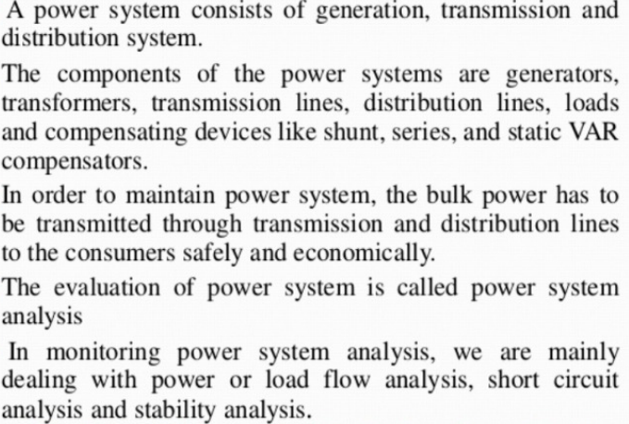
Overview of Power System Analysis

Slide 8
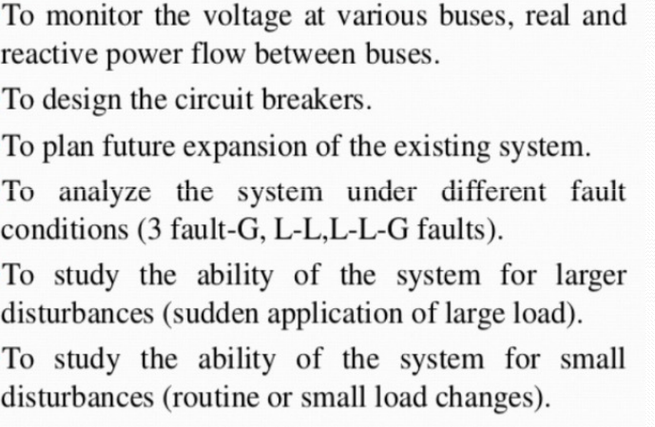
Functions of power system analysis

Slide 9
IMPORTANCE OF POWER SYSTEM ANALYSIS:
Power system analysis is crucial for the efficient, reliable, and economical operation of electrical power systems. It involves the study of generation, transmission, and distribution of electrical power to ensure stability, safety, and optimal performance. The key importance of power system analysis is as follows:
1. Ensuring System Stability and Reliability
Helps in maintaining voltage and frequency stability under normal and fault conditions.
Prevents blackouts and system failures by analyzing contingency scenarios.
2. Load Flow Analysis
Determines the voltage, current, power flow, and losses in the system.
Ensures proper load distribution among generators to maintain efficiency.
3. Fault Analysis
Identifies short-circuit and other fault conditions to design protective systems.
Helps in selecting appropriate circuit breakers and relays for system protection.

Slide 10
4. Economic Operation and Optimization
Reduces power losses and improves efficiency, leading to cost savings.
Helps in optimal power dispatch and load scheduling.
5. Protection System Design
Assists in designing protective relays, circuit breakers, and fuse coordination.
Ensures quick fault isolation to prevent damage to equipment.
6. Power Quality Improvement
Identifies voltage fluctuations, harmonics, and power factor issues.
Helps in mitigating power quality disturbances for smooth operation of electrical devices.
7. Expansion Planning and Upgrades
Supports decision-making for power system expansion, transmission line additions, and upgrades.
Ensures future demand is met without compromising system performanced adherence to grid codes.

Slide 11
APPLICATIONS:
1. Load Flow Analysis: Determines the voltage, current, and power flow in each branch of a power system to ensure efficient operation and prevent overloads.
2. Short Circuit Analysis: Identifies the potential impact of faults or short circuits in the system, helping to design protective measures and minimize damage.
3. Stability Analysis: Assesses the ability of the power system to maintain stable operation under various conditions, such as during faults or load changes.
4. Contingency Analysis: Evaluates the impact of potential failures or outages on the power system, aiding in the development of contingency plans.
5. Economic Dispatch: Optimizes the generation of power to minimize costs while meeting demand and maintaining system reliability.
6. Harmonic Analysis: Identifies and mitigates harmonics in the power system, which can cause equipment malfunctions and reduce efficiency.

Slide 12
THANKYOU

